Slide 1
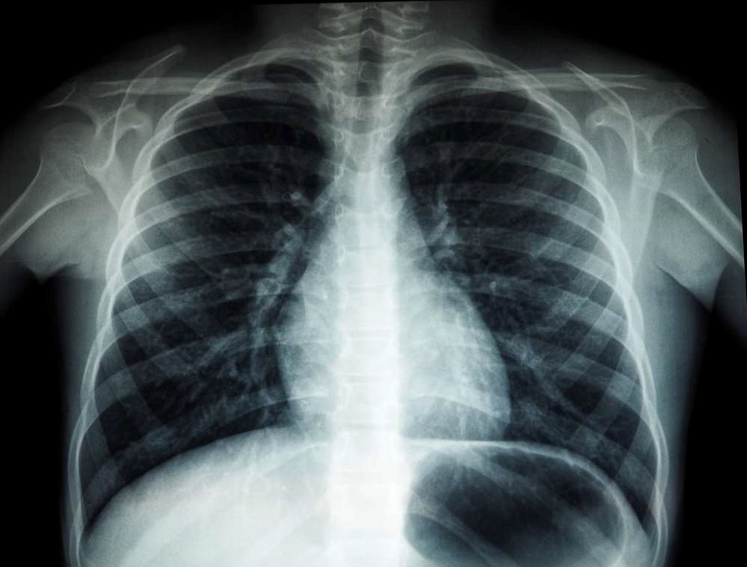
BY: Med-X (Team 1)
CS691
May 2024

Slide 2
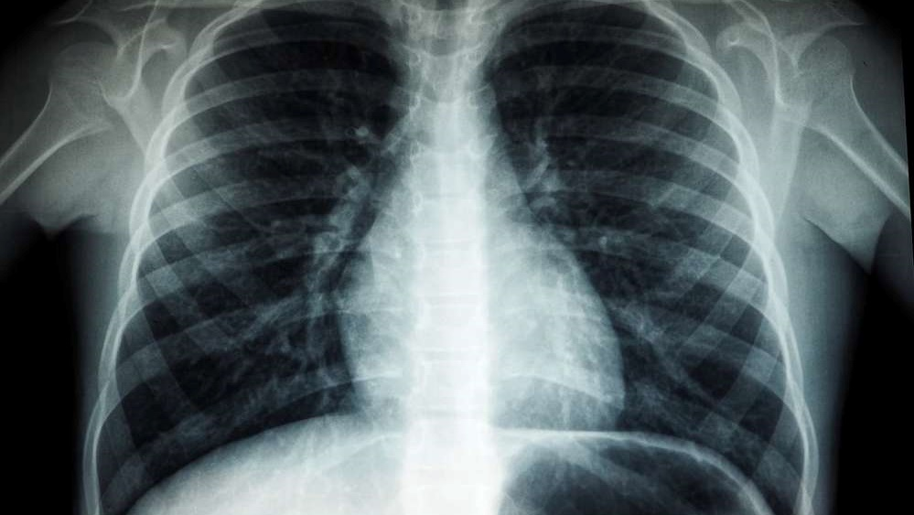

AGENDA:
01
02
03
04
05
Recap:
Member Names
Roles and Responsibilities
Improvements
Project Description
Team Working Agreement
Personas
Project Overview:
MVP
Languages and Tools
Algorithms
Diagrams
Sprint 3 Recap
Backlogs:
Product Backlog
Sprint 1,2,3 Summary
Sprint 4 Backlog
Test Cases
Story Completion
Team Metrics:
Team Velocity
Burndown Charts
Retrospective
Product:
Application Screenshots
API
Live Application Demo

Slide 3

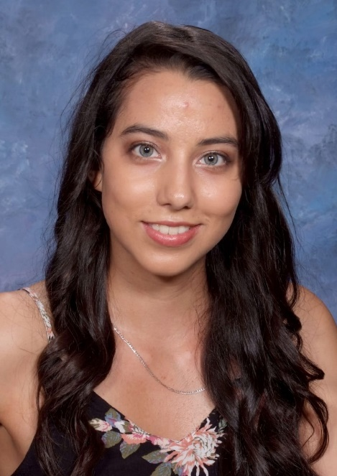

Team Roles and Responsibilities
Ronaldo Simbaña
Scrum Master | Developer
Marla Capistran
Team Leader | Database Admin
Filippo Zallocco
Developer

Slide 4


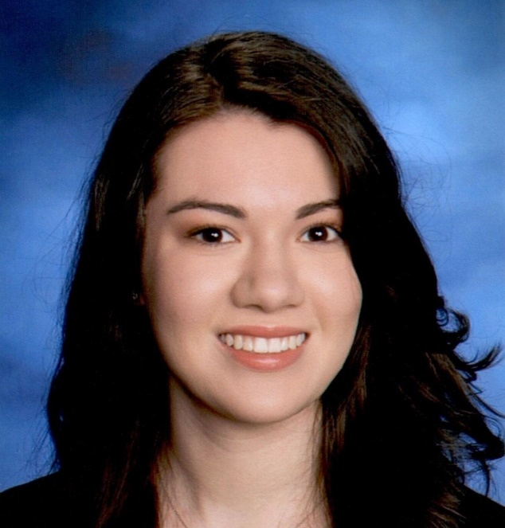
Team Roles and Responsibilities
Christopher Ospina
Developer
Anthony Muñoz
Quality Assurance / Tester Developer
Leanna Machado
Developer

Slide 5
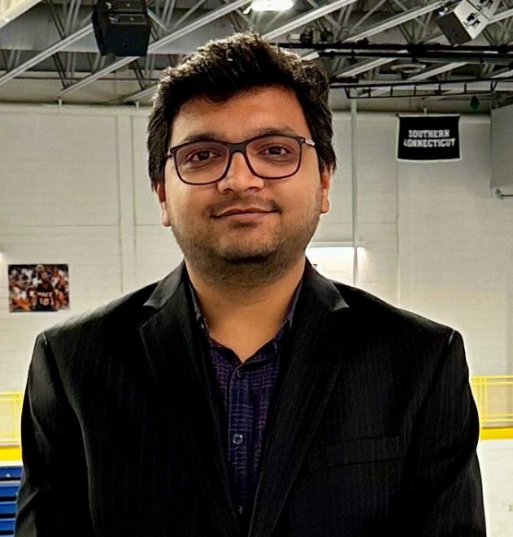

Team Roles and Responsibilities
Rahul Nayanegali
Developer
Prithvi Raimangya
Designer | Developer

Slide 6
Improvements
Renamed Sprint 4 Workload to Sprint 4 Backlog (slides 61 - 63)
Provide Explanations for the Burndown Charts (slides 73 - 75)
Include Assignee for each task / user story (slides 39 – 55, 57, 59, 61 – 63)
Improved order of conducting the Retrospective
Star indicates an improvement made

Slide 7
Problem Statement
Currently, x-ray machines are widely available; however, clinical chest x-ray images can be challenging to read and diagnose. Furthermore, x-rays are not a priority for radiologists, as they tend to focus more on CT images and MRIs. CT scans are both harmful and expensive, in addition to being time consuming.

Slide 8
Project Description
A web app that has a highly trained deep learning model that classifies x-ray images, reducing the need for a radiologist to examine them
Intended for medical professionals and patients who upload x-ray chest images
Uses a deep-neural network models that will detect common health issues
Our application will reduce the time it takes for a patient to receive their diagnosis using AI
Notes:
We could mention that x-rays are comparatively less hazardous, less expensive, and less time-consuming than CT scan images.

Slide 9
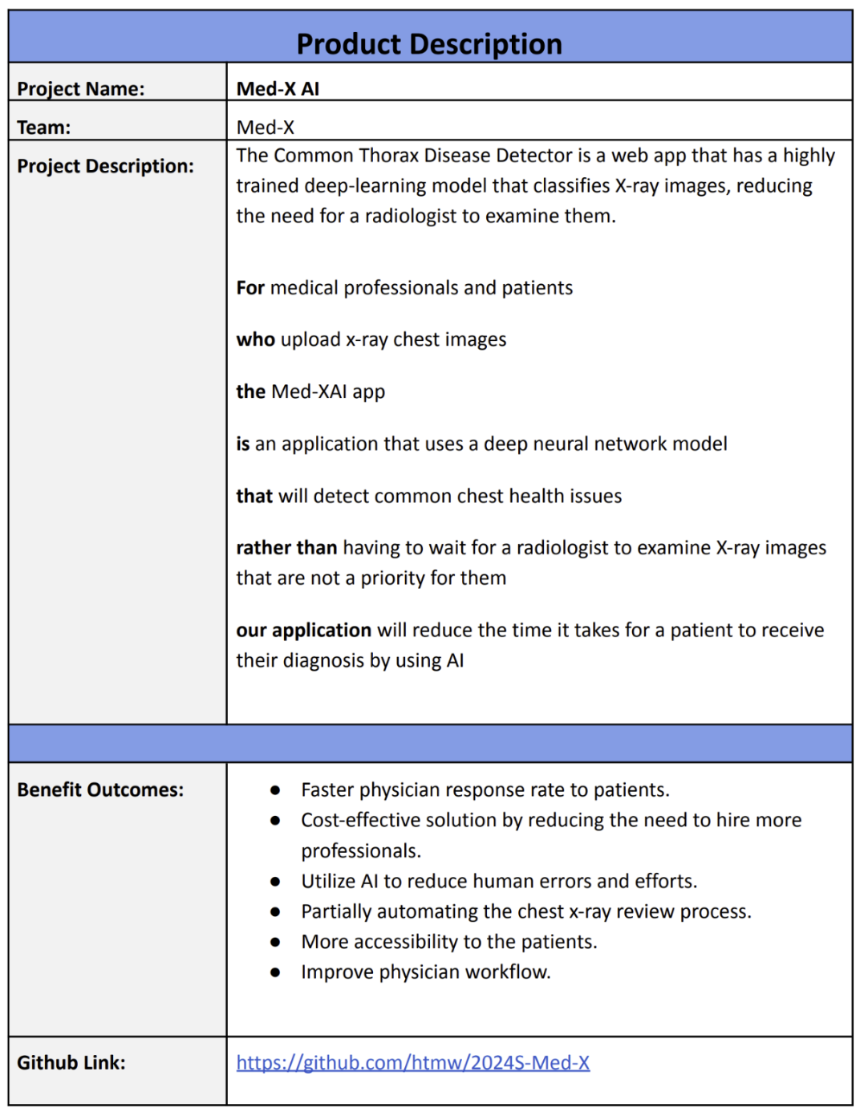
Project Description

Slide 10
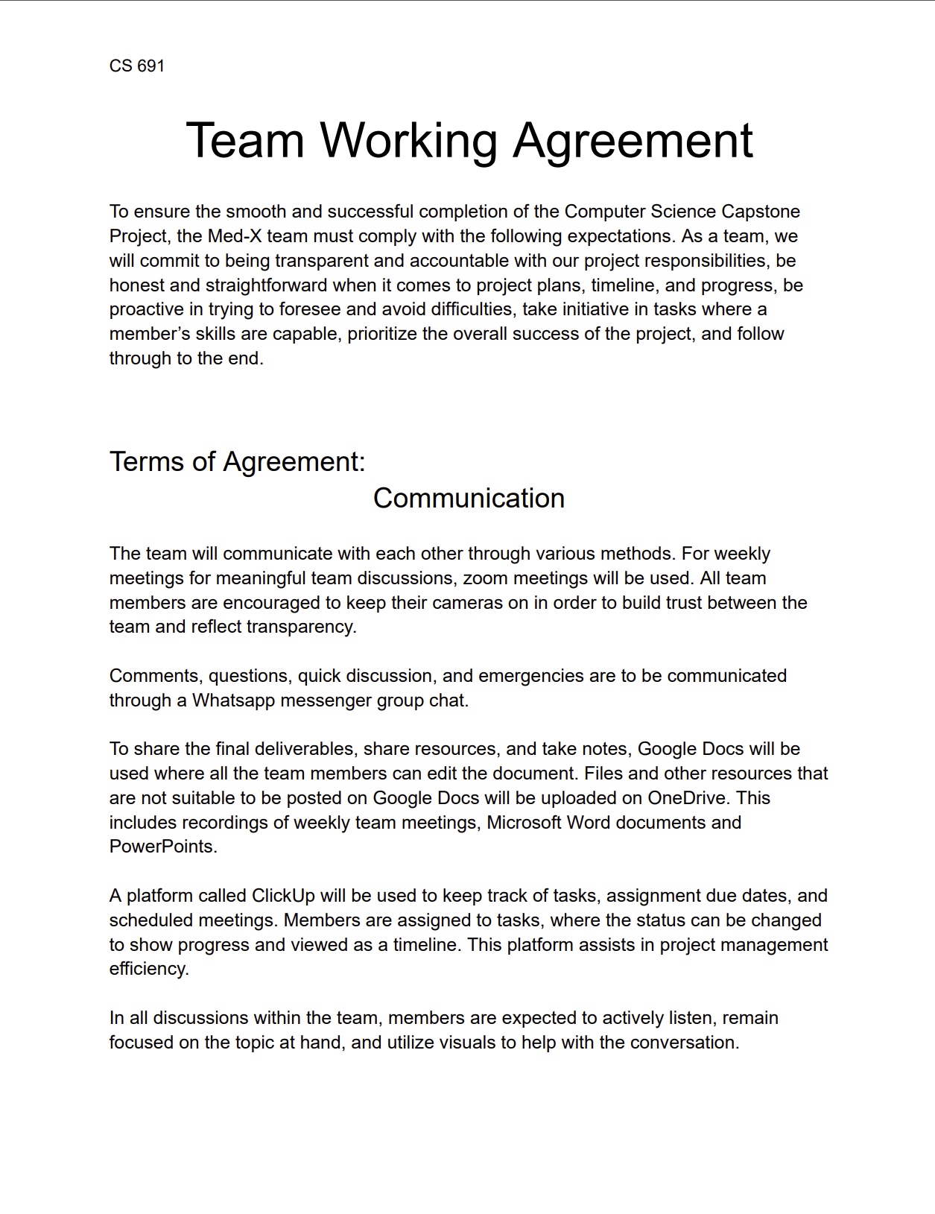
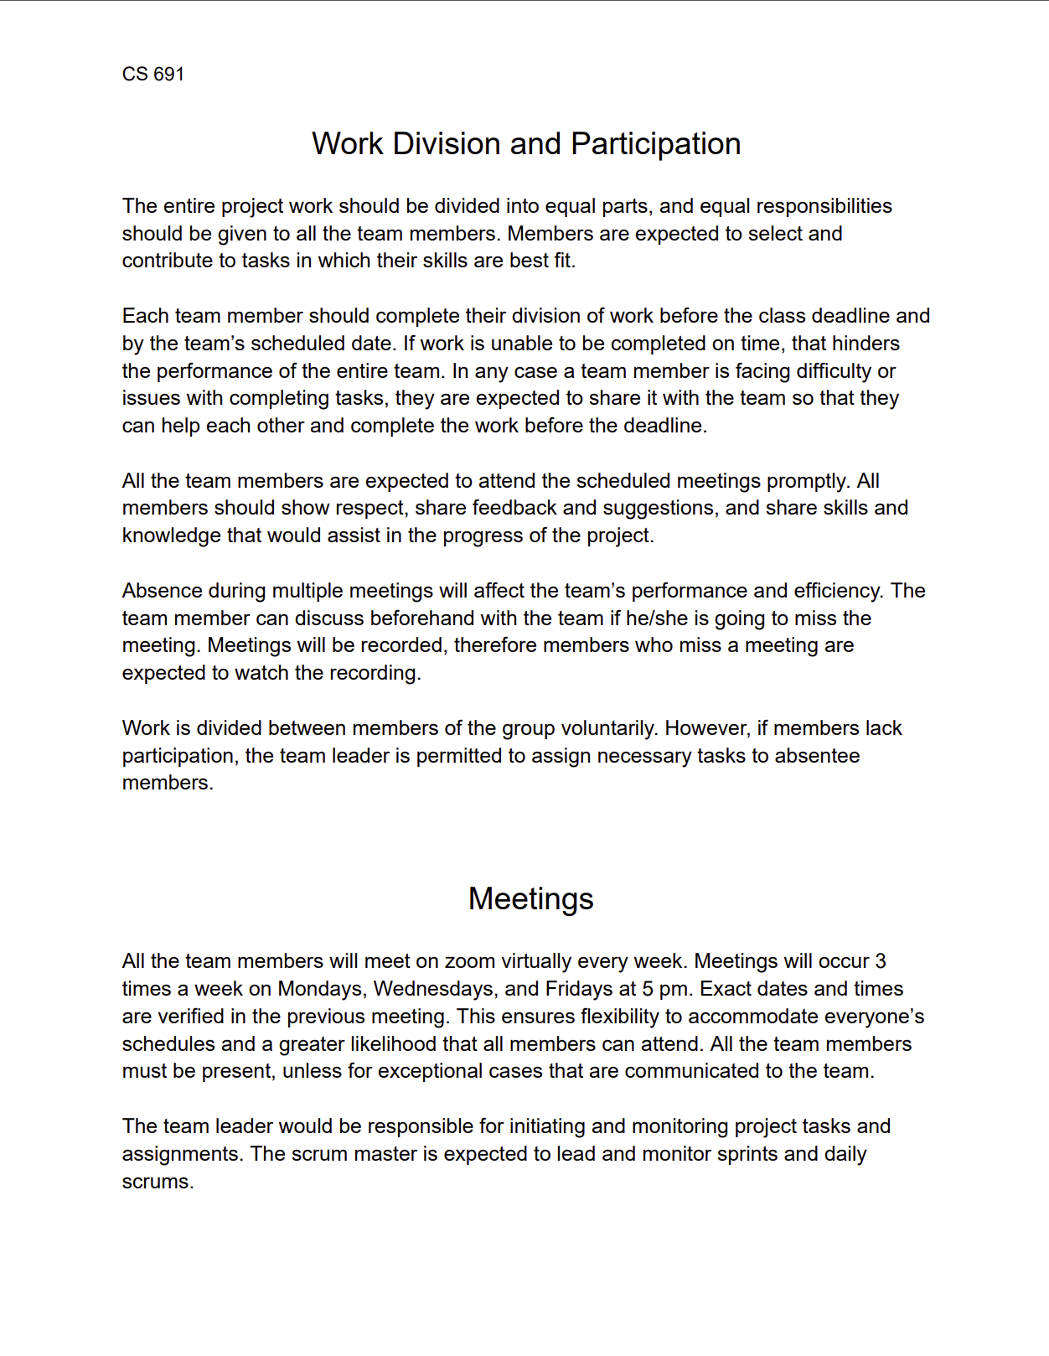
Team Working Agreement

Slide 11
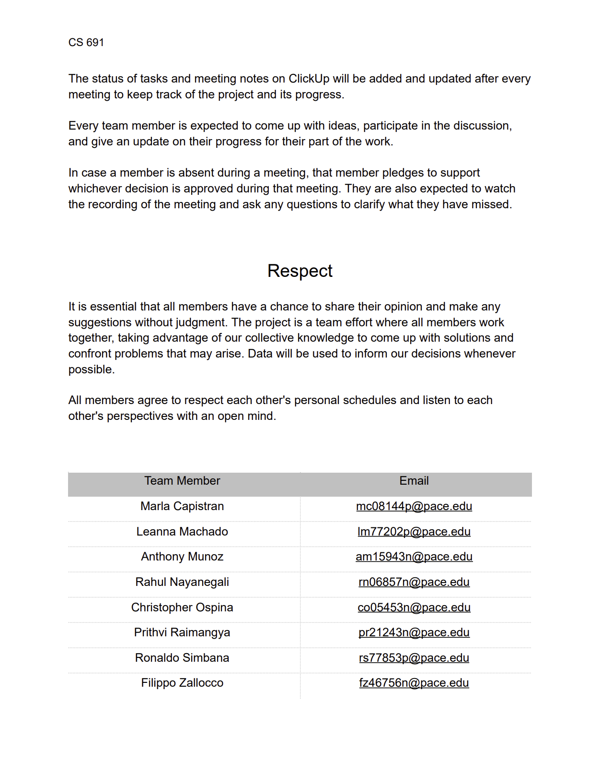
Team Working Agreement

Slide 12
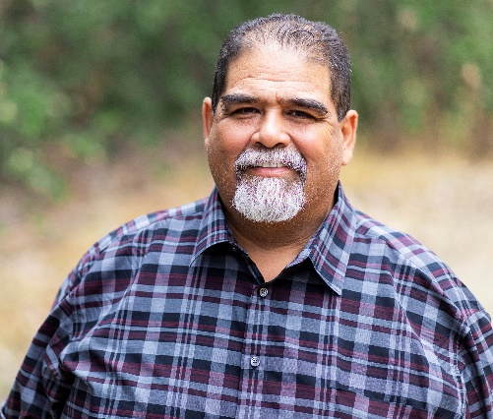
Patient Persona
Harold Castillo
Age: 55
Gender: Male
Occupation: Restaurant Owner
Location: Red Bank, NJ
Harold gets regular check-ups for a man his age but has trouble scheduling due to his job. It’d be great if he could just view his results and get an idea of what they mean and potential next steps without having to keep going in person.
Goals
View reports/results online
Able to connect with doctor about results online
Simple site for ease of use
Challenges
Making it to follow-ups for results
Understanding the results, even after a consultation
Time taken to receive results

Slide 13

Radiologist Persona
Sandro Cuccigno
Age: 50
Gender: Male
Occupation: Radiologist
Location: Manhattan, NY
Hospital: NYU Langone Medical Center
Has been in the practice for 20 years. His team is understaffed and under equipped. Is often exhausted from reviewing x-rays and informing people they have a serious illness.
Goals
Process chest images fast
Help hospital tend to patients
Improve workflow for his team
Challenges
Increasing patient volumes
Burnout from long shift and nature of the job
Facility cutting funds
Spends many hours reviewing x-rays

Slide 14
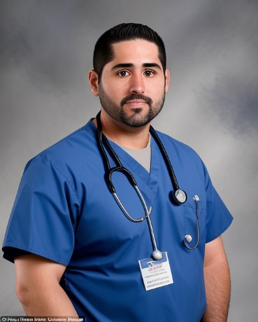
Doctor Persona
Dr. Bryce Ruiz
Age: 34
Gender: Male
Occupation: Doctor
Location: Fresno, Ca
Hospital: Albuquerque Medical Center
A 34-year-old medical professional from Fresno. Has been working at Albuquerque for over 10 years and has recently been promoted to Cardiology to conduct x-rays
Goals
Build a strong reputation with patients
Explain to patients what they have in a clear manner
Challenges
Large volume of patients
Limited time for consultations
Patients are often confused about their diagnosis

Slide 15
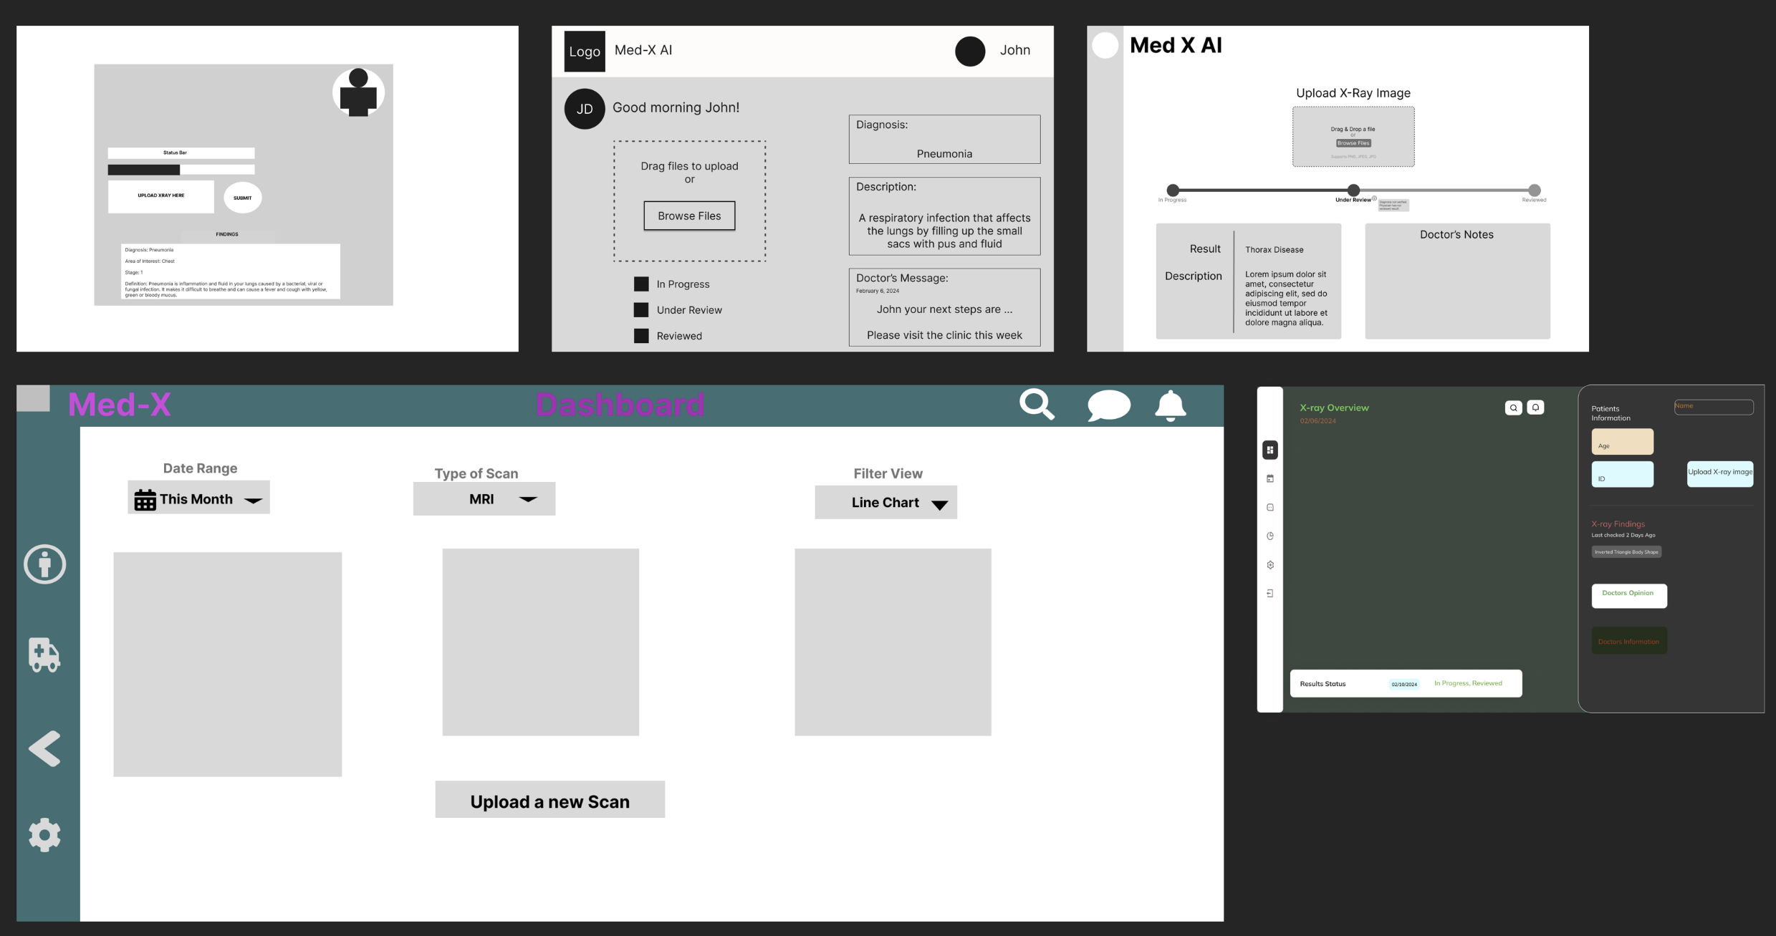
Product Discovery

Slide 16
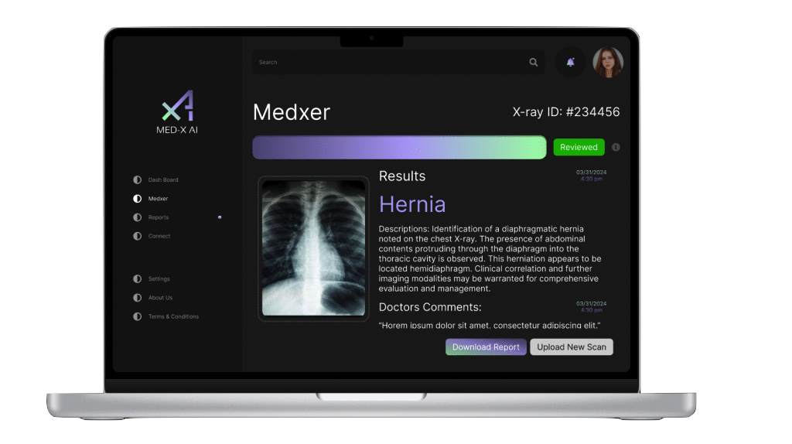
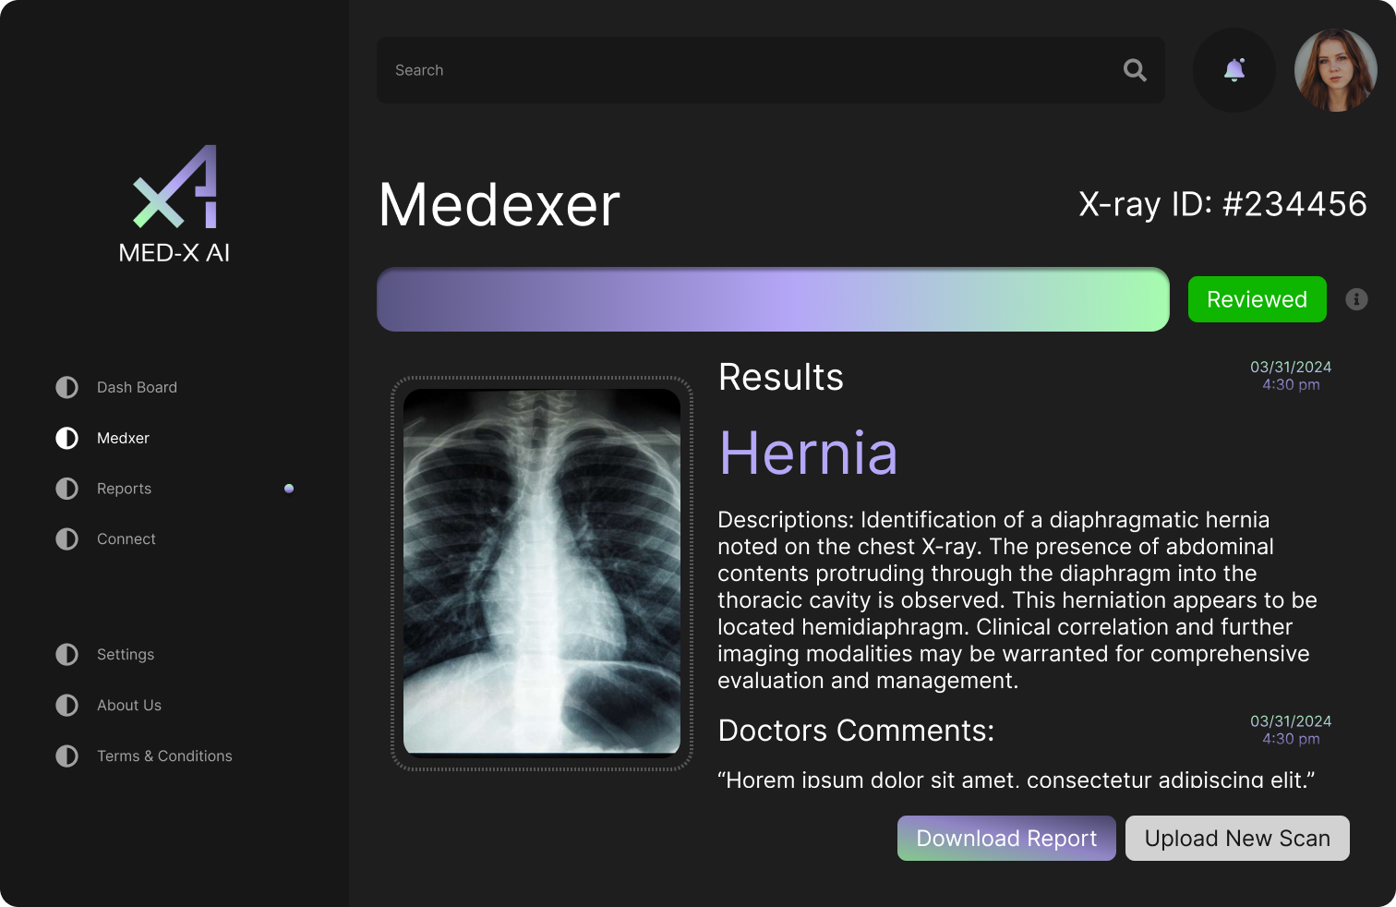
Final Product Design

Slide 17
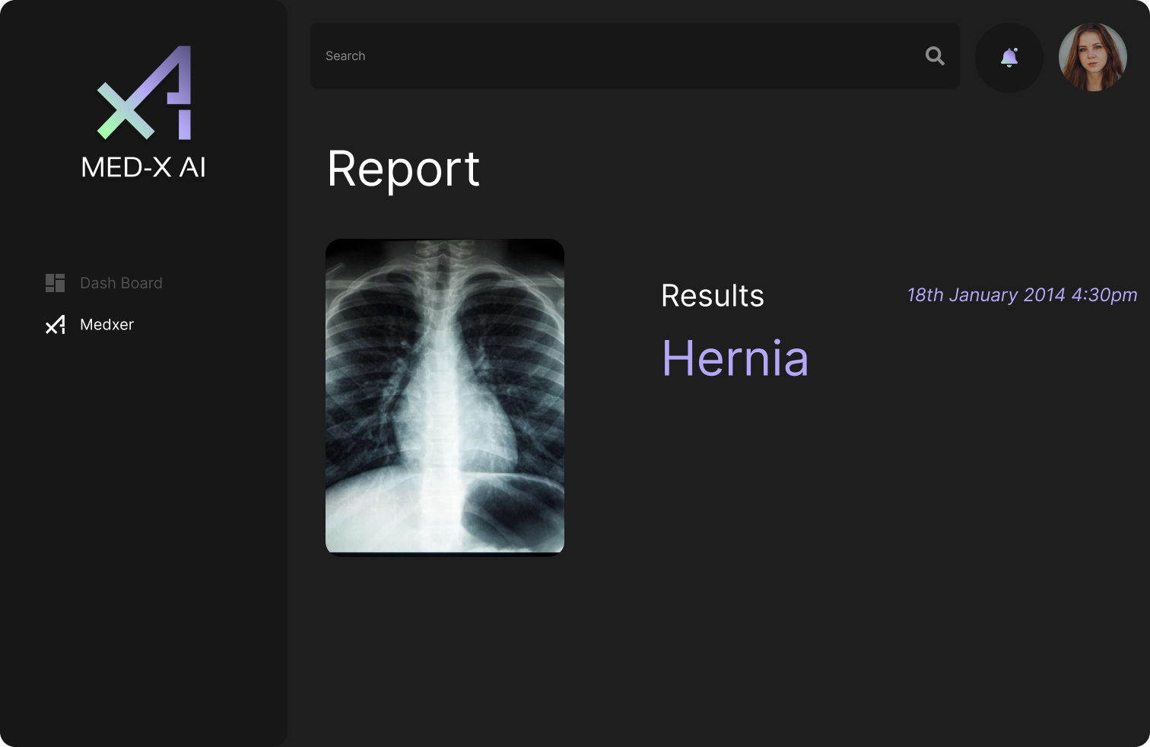
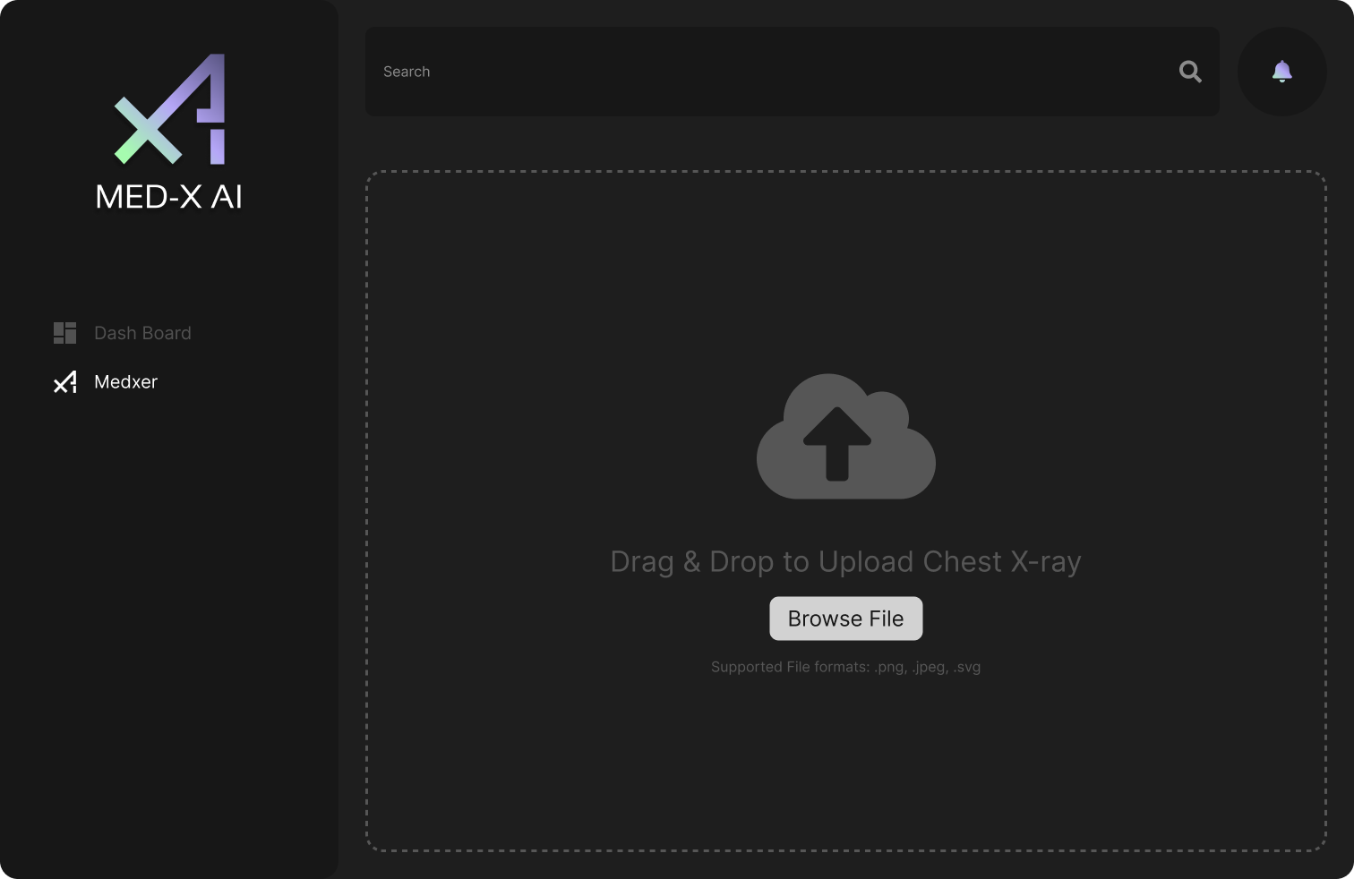
MVP Design

Slide 18

















Technologies & Algorithms
Programming Languages
and Frameworks
Algorithms
Database
Tools
Firebase
Figma
VSCode
HTML5
CSS
JavaScript
TensorFlow
CNN
Docker
GitHub
React
NodeJS
Flask
Keras
Python
Tailwind CSS
Insomnia

Slide 19
Technologies Explanation
HTML5
CSS
JavaScript
Flask
Python
Firebase
React
NodeJS
Tailwind CSS
MedX app leverages HTML, CSS, JavaScript, React, Node and Tailwind CSS for the dynamic user interface
Python's micro framework Flask is used to render the chest x-ray findings on the user interface by calling the trained model
Firebase is used to store the uploaded image and provides an endpoint URL to call the API

Slide 20
Technologies Explanation
Figma
VSCode
Insomnia
Docker
GitHub
Figma, VSCode, and GitHub are tools used for efficient collaboration. Figma enables a seamless contribution for the overall development. VSCode is the chosen code editor. GitHub allows remote version control and collaborative development. Docker simplifies deployment across all platforms. Insomnia is a tool used to test the APIs.

Slide 21
Algorithms Explanation
TensorFlow's Keras API is used for building and training our Convolutional Neural Network, which classifies x-ray images for diagnosis. The deep learning model integrates different layers.
Convolutional Layers
Batch Normalization
Dropout
Regularization
We optimized training with the Adam algorithm
TensorFlow
Keras
CNN

Slide 22
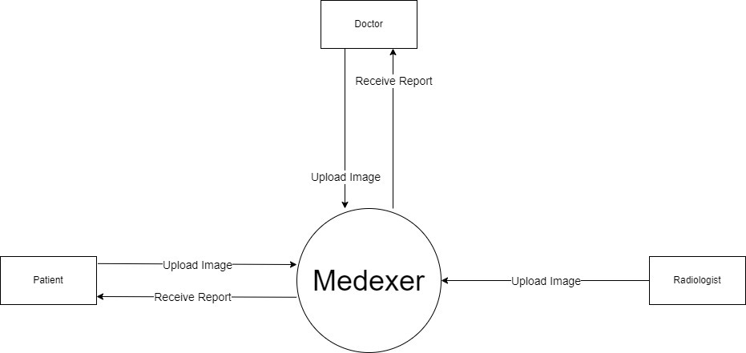
Context Diagram

Slide 23
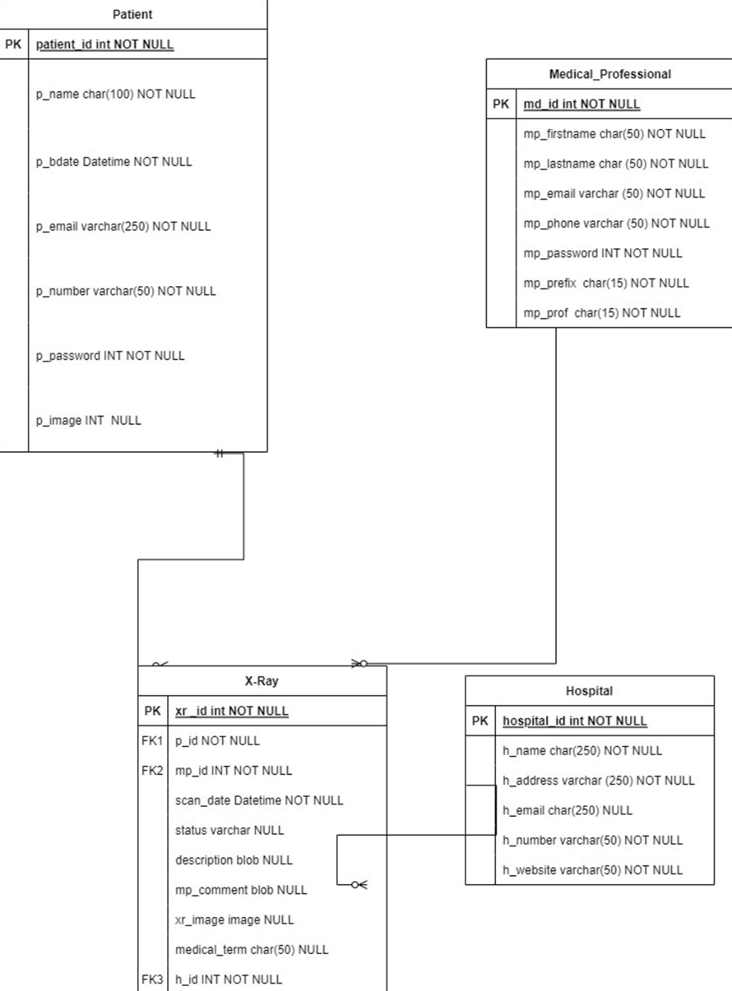
Class Diagram

Slide 24
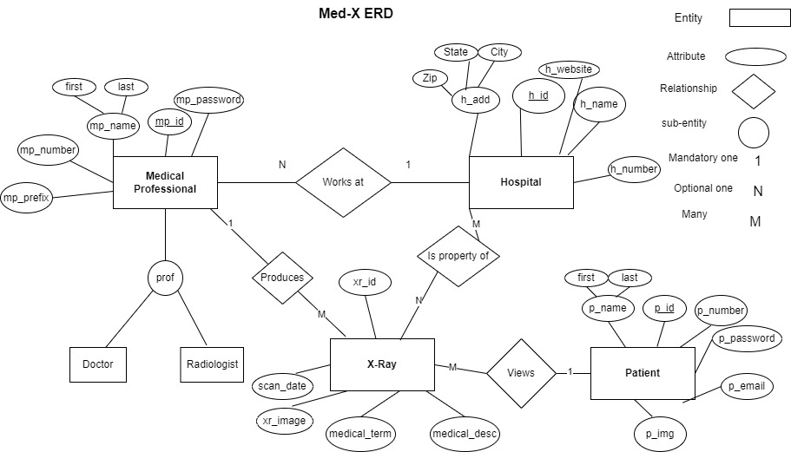
ER Diagram

Slide 25
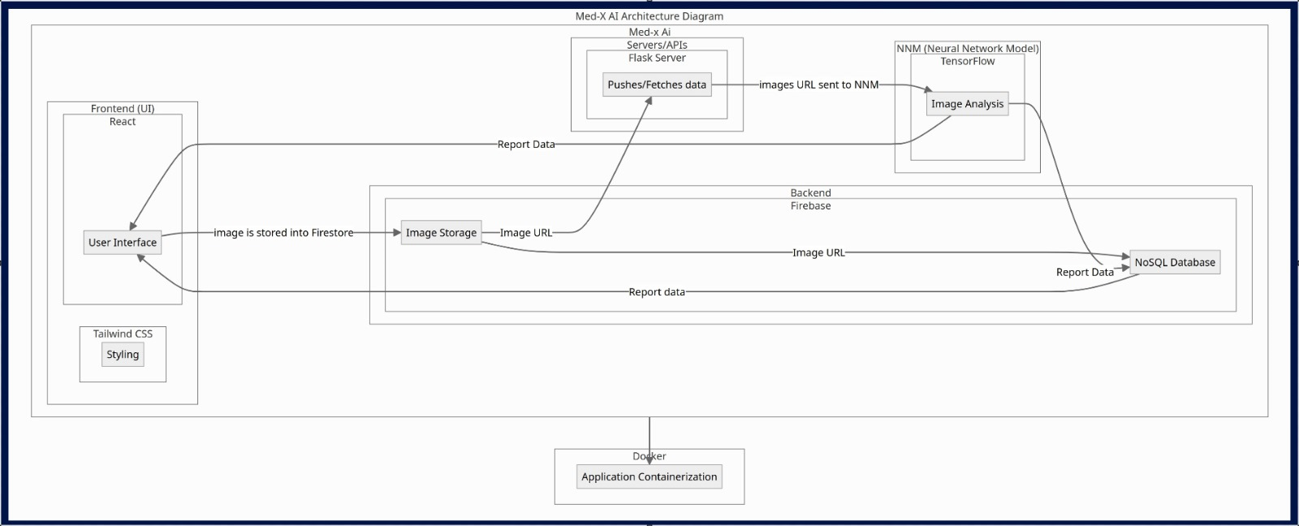
Architecture Diagram

Slide 26
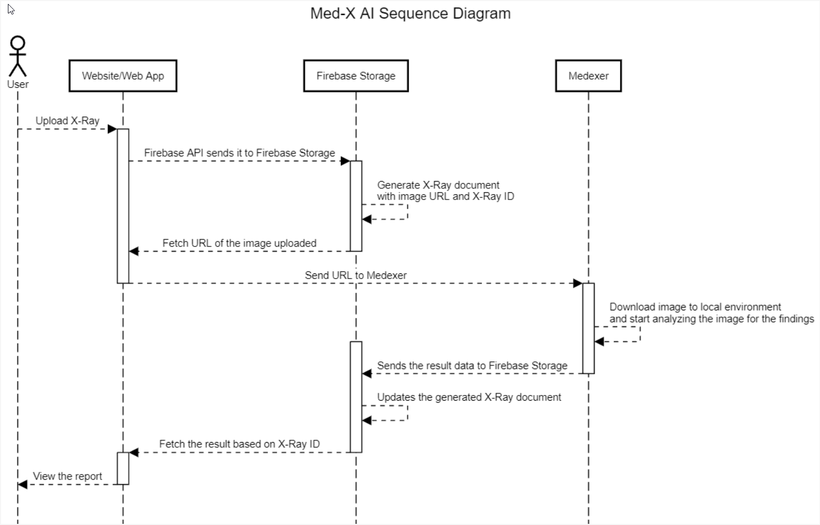
Sequence Diagram

Slide 27
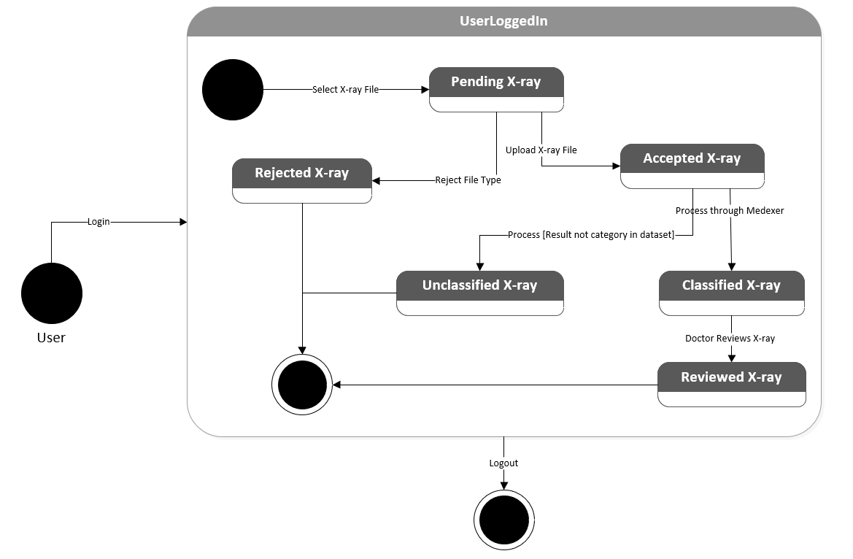
State Diagram

Slide 28
Sprint 3 Recap
Added functionality to the Search bar (date, report id, diagnosis, status)
Able to view reports added
Doctor's Notes
Status of the Report Changes once verified by the doctor
Static UI for patient and doctor login
Ability to download a report to a device
Ability to print a report
Displaying the most recent report on the Dashboard
Self-developed Neural Network Model
33 Story Points
Completed 100% of the Story Points

Slide 29
Product Backlog
Description | Assignee
Select VS Code, Docker, No SQL database for web application development | Med-X Team
Train the basic neural network model with NIH dataset | Rahul
Check current versions of Node and ensure everyone runs version 20.8 | Med-X Team
Create a base application in React JS and use Tailwind CSS for styling | Prithvi
Create Database Tables in Firebase | Filippo / Marla
Test alternative backend API with MongoDB | Filippo / Marla
Build Flask server to integrate the neural network model | Filippo / Rahul
Import dependencies from Firebase to connect app to Google services | Filippo
Dockerize front-end and back-end for cross-platform compatibility | Filippo
Increase Accuracy of neural network model by using CheXpert dataset | Rahul
Legend:
Sprint 1
Sprint 2
Sprint 3
Sprint 4

Slide 30
Product Backlog
Description | Assignee
Integrate the new model by modifying the API functionality | Rahul
Attempt to deploy back-end to Google Cloud Console and AWS | Filippo / Prithvi / Ronaldo / Rahul
Read documentations and follow tutorials about CRUD operations with Firebase | Filippo / Leanna
Read through various medical descriptions for diagnoses and create an excel file with friendly descriptions | Marla
Update features such as Doctor's Comment, Reviewed Status, Download Report, Dashboard, Search | Med-X Team
Create a static Login Page for patient and doctor | Prithvi
Test the application on multiple devices and troubleshoot | Anthony
Confirm the friendly medical descriptions with nurses and doctors | Rahul / Leanna
Explore and Train alternative optimization algorithms for higher accuracy | Rahul
Legend:
Sprint 1
Sprint 2
Sprint 3
Sprint 4

Slide 31
Product Backlog
Estimation | User Story ID | As a | I want | So that | Feature | Assignee
3 | 1 | Radiologist | to easily upload x-ray images | doctors and patients have access to the images | Image Upload | Ronaldo / Prithvi / Filippo
3 | 2 | Doctor | to easily upload x-ray images | doctors and patients have access to the images | Image Upload | Ronaldo / Prithvi / Filippo
3 | 3 | Patient | to easily upload x-ray images from my personal machine | doctors have access to the images for review | Image Upload | Ronaldo / Prithvi / Filippo
13 | 4 | Radiologist | to provide quick and automated x-ray results for common chest health issues | more time can be dedicated to analyze uncommon chest health issues | Medexer (AI) | Rahul
13 | 5 | Doctor | to provide quick and automated x-ray results for common chest health issues | patient response rate and physician workflow improves | Medexer (AI) | Rahul
8 | 6 | Doctor | to add comments to patient x-ray results | patients are informed early about other information the result does not provide | Doctor Notes | Leanna / Prithvi / Ronaldo / Filippo
Legend:
Sprint 2
Sprint 3
Sprint 4

Slide 32
Product Backlog
Estimation | User Story ID | As a | I want | So that | Feature | Assignee
5 | 7 | Patient | to view whether a doctor has reviewed my x-ray results | I can be more confident about the verified results | Reviewed Status | Prithvi
2 | 8 | Patient | my x-ray results to be explained in simpler terms | I can better understand my diagnosis and health issue | Result Description | Rahul / Prithvi / Marla
1 | 9 | Doctor | to download patient x-ray reports | I can store patient records locally | Download Report | Chris / Prithvi
1 | 10 | Patient | to download my x-ray reports | I can store patient records locally | Download Report | Chris / Prithvi
5 | 11 | Patient | to have access to all of my x-ray report history | I can track my chest health issues | Report History | Prithvi / Marla
5 | 12 | Doctor | to have access to all patient x-ray report histories | I can track patient chest health issues | Report History | Prithvi / Marla
2 | 13 | Patient | to quickly view my latest x-ray report | my most recent information is easily accessible | Dashboard | Ronaldo / Prithvi
Legend:
Sprint 2
Sprint 3
Sprint 4

Slide 33
Product Backlog
Estimation | User Story ID | As a | I want | So that | Feature | Assignee
5 | 14 | Patient | to be notified once there is a change to my reports (upload, review, notes, etc.) | I can be informed about any updates as soon as possible | Notification | Leanna / Filippo
5 | 15 | Doctor | to be notified once there is a change to patient reports (upload, report, etc.) | I can be informed about any updates as soon as possible | Notification | Leanna / Filippo
8 | 16 | Doctor | to browse a specific report and record | I can quickly locate specified information | Search | Ronaldo / Prithvi
8 | 17 | Patient | to browse a specific report and record | I can quickly locate specified information | Search | Ronaldo / Prithvi
3 | 18 | Radiologist | to register and store my personal info (ID, name, D.O.B.) in my own account | I can access patient information and connect with patients and doctors privately | Registration/ Signup | Ronaldo / Prithvi
Legend:
Sprint 2
Sprint 3
Sprint 4

Slide 34
Product Backlog
Estimation | User Story ID | As a | I want | So that | Feature | Assignee
3 | 19 | Doctor | to register and store my personal info (ID, name, D.O.B.) in my own account | I can access patient information and connect with patient and radiologists privately | Registration/ Signup | Ronaldo / Prithvi
3 | 20 | Patient | to register and store my personal info (ID, name, D.O.B.) in my own account | I can access my medical information and connect with doctors privately | Registration/ Signup | Ronaldo / Prithvi
3 | 21 | Patient | to login and logout of my own account | my medical information, records and reports are secure | Login/Logout | Prithvi / Ronaldo
3 | 22 | Doctor | to login and logout of my own account | Patient medical information, records and reports are secure | Login/Logout | Prithvi / Ronaldo
3 | 23 | Patient | to login using my e-mail address | I can access my medical information, records and reports | Login/Logout | Ronaldo
3 | 24 | Doctor | to login using my medical professional ID number | I can access patient medical information, records and reports | Login/Logout | Ronaldo
Legend:
Sprint 2
Sprint 3
Sprint 4

Slide 35
Product Backlog
Estimation | User Story ID | As a | I want | So that | Feature | Assignee
1 | 25 | Patient | update my personal information such as my name, address, phone number etc. | the portal has up-to-date information in the event I need to be reached urgently | Profile | Anthony / Chris
Legend:
Sprint 2
Sprint 3
Sprint 4

Slide 36
User Stories
User Story ID | Scenario | Summary | Criteria | Feature | Assignee
1 | As a Radiologist I want to easily upload x-ray images so that doctors and patients have access to the images
 | A radiologist wants to upload an x-ray image | Given I'm a radiologist when I open the Med-X AI web app I should be able to locate an upload button that when clicked on and an image is selected then the application will store the image for processing | Med-X AI App will store the image for processing | Image Upload | Ronaldo / Prithvi / Filippo
2 | As a Doctor I want to easily upload x-ray images so that doctors and patients have access to the images
 | A doctor wants to upload an x-ray image | Given I'm a doctor when I open the Med-X AI web app I should be able to locate an upload button that when clicked on and an image is selected then the application will store the image for processing | Med-X AI App will store the image for processing | Image Upload | Ronaldo / Prithvi / Filippo
3 | As a Patient I want to easily upload x-ray images from my personal machine so that doctors have access to the images for review
 | A patient wants to upload an x-ray image | Given I'm a patient when I open the Med-X AI web app I should be able to locate an upload button that when clicked on and an image is selected then the application will store the image for processing | Med-X AI App will store the image for processing | Image Upload | Ronaldo / Prithvi / Filippo
Legend:
Sprint 2
Sprint 3
Sprint 4

Slide 37
User Stories
User Story ID | Scenario | Summary | Criteria | Feature | Assignee
4 | As a Radiologist I want to provide quick and automated x-ray results for common chest health issues so that more time can be dedicated to analyze uncommon chest health issues
 | A radiologist wants to quickly provide an x-ray result | Given I'm a radiologist when I upload an x-ray image then the application will provide a quick diagnosis | Med-X AI App will provide a diagnosis (finding) for the chest health issue | Medexer (AI) | Rahul
5 | As a Doctor I want provide quick and automated x-ray results for common chest health issues so that patient response rate and physician workflow improves
 | A doctor wants to quickly access patient x-ray results | Given I'm a doctor when an x-ray image produces quick results I can then access the result in order to provide patients with a verified response | Med-X AI App will provide a diagnosis (finding) for the chest health issue | Medexer (AI) | Rahul
6 | As a Doctor I want to add comments to patient results so that patients are informed early about other information the result does not provide
 | A doctor wants to write a comment to patient about the x-ray result | Given I'm a doctor when I click on the Doctor's Comments section on a patient's report I can then type and post a message that the patient can see | Med-X AI App will provide a text message section for each report to allow doctors to post | Doctor Notes | Leanna / Prithvi / Ronaldo / Filippo
Legend:
Sprint 2
Sprint 3
Sprint 4

Slide 38
User Stories
User Story ID | Scenario | Summary | Criteria | Feature | Assignee
7 | As a Patient I want to view whether a doctor has reviewed my x-ray results so that I can be more confident about the verified results
 | A patient wants to see any additional comments from the doctor | Given I'm a patient when I click on a report in Reports, I can then view a status bar reporting if a doctor has verified the x-ray result | Med-X App will allow patients to view "Under Review" or "Reviewed" status bar in reports | Reviewed Status | Prithvi
8 | As a Patient I want my x-ray results to be explained in simpler terms so that I can better understand my diagnosis and health
 | A patient wants to better understand their x-ray result | Given I'm a patient when I click on a report in Reports tab, I can then view a text description of the result in plain language so I can better understand the technical result | Med-X AI App will provide a text description of the finding in the selected report | Result Description | Rahul / Prithvi / Marla
9 | As a Doctor I want to download patient x-ray reports so that I can store patient records locally
 | A Doctor wants to store patient records locally | Given I'm a doctor when I open a patient's report and click a download button the selected record is then downloaded and saved to my local computer | Med-X AI App will transfer the report file from the remote system to the user's local system | Download Report | Chris / Prithvi
Legend:
Sprint 2
Sprint 3
Sprint 4

Slide 39
User Stories
User Story ID | Scenario | Summary | Criteria | Feature | Assignee
10 | As a Patient I want to download my x-ray reports so that I can store my records locally
 | A patient wants to store medical records locally | Given I'm a patient when I open my report and click a download button the selected report is then downloaded and saved to my local computer | Med-X AI App will transfer the report file from the remote system to the user's local system | Download Report | Chris / Prithvi
11 | As a Patient I want to have access to my x-ray report history so that I can track my chest health issues
 | A patient wants to keep track of all of their x-ray reports | Given I'm a patient when I click on the Reports tab then I should see a gallery of reports that have been generated | Med-X AI App will store all the reports in the cloud | Report History | Prithvi / Marla
12 | As a Doctor I want to have access to patient x-ray report histories so that I can track patient chest health issues
 | A doctor wants to keep track of their patients reports | Given I'm a doctor when I click on the Reports tab of a specific patient then I should see a gallery of reports that has been generated for that patient | Med-X AI App will store all the reports in the cloud | Report History | Prithvi / Marla
Legend:
Sprint 2
Sprint 3
Sprint 4

Slide 40
User Stories
User Story ID | Scenario | Summary | Criteria | Feature | Assignee
13 | As a Patient I want to quickly view my latest x-ray report so that my most recent information is easily accessible
 | A patient wants to view their latest x-ray report | Given I'm a patient when I log into the account then the Dashboard page will be displayed with the most recent x-ray results | Med-X AI App will open to the Dashboard upon sign in | Dashboard | Ronaldo / Prithvi
14 | As a Patient I want to be notified once there is a change to my reports (upload, review, notes, etc.) so that I can be informed about any updates as soon as possible
 | A patients wants to be informed of any changes to their reports | Given I'm a patient when a change is made to my report then I should receive a notification | Med-X AI App will alert the user of a change made to their report | Notification | Leanna / Filippo
15 | As a Doctor I want to be notified once there is a change to patient reports (upload, report, etc.) so that I can be informed about any updates as soon as possible
 | A doctor wants to be informed of any changes to patient reports | Given I'm a doctor when a change is made to a patient report then I should receive a notification | Med-X AI App will alert the user of a change made to their report | Notification | Leanna / Filippo
Legend:
Sprint 2
Sprint 3
Sprint 4

Slide 41
User Stories
User Story ID | Scenario | Summary | Criteria | Feature | Assignee
16 | As a Doctor I want to browse all reports and records so that I can quickly locate specified information
 | A doctor wants to locate a specific report/record | Given I'm a doctor when I search for a report in the search bar then I should be able to quickly locate it | Med-X AI App will store reports using an x-ray id and patient name | Search | Ronaldo / Prithvi
17 | As a Patient I want to browse my reports and records so that I can quickly locate specified information
 | A patient wants to locate a specific report/record | Given I'm a patient when I search for a report in the search bar then I should be able to quickly locate it | Med-X AI App will store reports using an x-ray id | Search | Ronaldo / Prithvi
18 | As a Radiologist I want to register and store my personal info (ID, name, DOB) in my own account so that I can access patient information and connect to patients and doctors privately
 | A radiologist wants to create their own account to securely access patient information | Given I'm a radiologist when I use the app, I should be able to have my own account then patient information will be secured, and communication will be private | Med-X AI App will store user credentials (medx ID) | Registration/ Signup | Ronaldo / Prithvi
Legend:
Sprint 2
Sprint 3
Sprint 4

Slide 42
User Stories
User Story ID | Scenario | Summary | Criteria | Feature | Assignee
19 | As a Doctor I want to register and store my personal info (ID, name, DOB) in my own account so that I can access patient information and connect to patients and radiologists privately
 | A doctor wants to create their own account to securely access patient information | Given I'm a doctor when I use the app, I should be able to have my own account then patient information will be secured, and communication will be private | Med-X AI App will store user credentials (medx ID) | Registration/ Signup | Ronaldo / Prithvi
20 | As a Patient I want to register and store my personal info (ID, name, DOB) in my own account so that I can access my medical information and connect to doctors privately
 | A patient wants to create their own account to securely access their information | Given I'm a patient when I use the app, I should be able to have my own account then my information will be secured, and communication will be private | Med-X AI App will store email and password | Registration/ Signup | Ronaldo / Prithvi
Legend:
Sprint 2
Sprint 3
Sprint 4

Slide 43
User Stories
User Story ID | Scenario | Summary | Criteria | Feature | Assignee
21 | As a Patient I want to login and logout of my own account so that my medical information, records and reports are secure
 | A patient wants to securely and privately start and end sessions on their account | Given I'm a patient when I open the app, I then am prompted to log in to my account with my credentials and click a logout button to end my session | Med-X AI App will begin with a login page and have a button to logout of the current account | Login/ Logout | Prithvi / Ronaldo
22 | As a Doctor I want to login and logout of my own account so that patient medical information, records and reports are secure
 | A doctor wants to securely and privately start and end sessions on their account | Given I'm a doctor when I open the app, I then am prompted to log in to my account with my credentials and click a logout button to end my session | Med-X AI App will begin with a login page and have a button to logout of the current account | Login/ Logout | Prithvi / Ronaldo
Legend:
Sprint 2
Sprint 3
Sprint 4

Slide 44
User Stories
User Story ID | Scenario | Summary | Criteria | Feature | Assignee
23 | As a Patient I want to login using my e-mail address so that I can access my medical information, records and reports
 | A patient wants to access their medical records by using their personal e-mail address | Given I'm a patient when I am prompted to login, I can then enter my personal e-mail address to access the records related to my account | Med-X AI App will create and store patient accounts through e-mail (username) | Login/Logout | Ronaldo
24 | As a Doctor I want to login using my medical professional ID number so that I can access patient medical information, records and reports
 | A doctor wants to access patient medical records by using their ID number | Given I'm a doctor when I am prompted to login, I can then enter my personal medx ID number to access the records related to my account | Med-X AI App will create and store doctor accounts through their ID number (username) | Login/Logout | Ronaldo
Legend:
Sprint 2
Sprint 3
Sprint 4

Slide 45
User Stories
User Story ID | Scenario | Summary | Criteria | Feature | Assignee
25 | As a Patient I want to update my personal information such as my name, address, phone number, etc. so that the portal has up-to-date information in the event I need to be reached urgently
 | A patient wants to update personal profile information when they change | Given I'm a patient when I click my profile and the edit button, I can then change the inputted profile information (name, address, phone number, etc.) and click save | Med-X AI App will allow patients to update profile information and store the changes in the database | Profile | Anthony / Chris
Legend:
Sprint 2
Sprint 3
Sprint 4

Slide 46
Sprint 1 Summary:
Found a problem in the health sector
Came up with a Team Name
Established team roles
Researched user challenges (radiologist, patient, doctor)
Brainstormed how AI can benefit users
Designed Team Logo
Determine the type of application to build
Wireframing and Prototyping the App Design
Researched technologies to use

Slide 47
Sprint 2 Summary:
Estimation | User Story ID | As a | I want | So that | Feature | Assignee
3 | 1 | Radiologist | to easily upload x-ray images | doctors and patients have access to the images | Image Upload | Ronaldo / Prithvi / Filippo
3 | 2 | Doctor | to easily upload x-ray images | doctors and patients have access to the images | Image Upload | Ronaldo / Prithvi / Filippo
3 | 3 | Patient | to easily upload x-ray images from my personal machine | doctors have access to the images for review | Image Upload | Ronaldo / Prithvi / Filippo
13 | 4 | Radiologist | to provide quick and automated x-ray results for common chest health issues | more time can be dedicated to analyze uncommon chest health issues | Medxer (AI) | Rahul
13 | 5 | Doctor | quick access to patient x-ray results for common chest health issues | patient response rate and physician workflow improves | Medxer (AI) | Rahul
Sprint 2 Story Points: 35

Slide 48
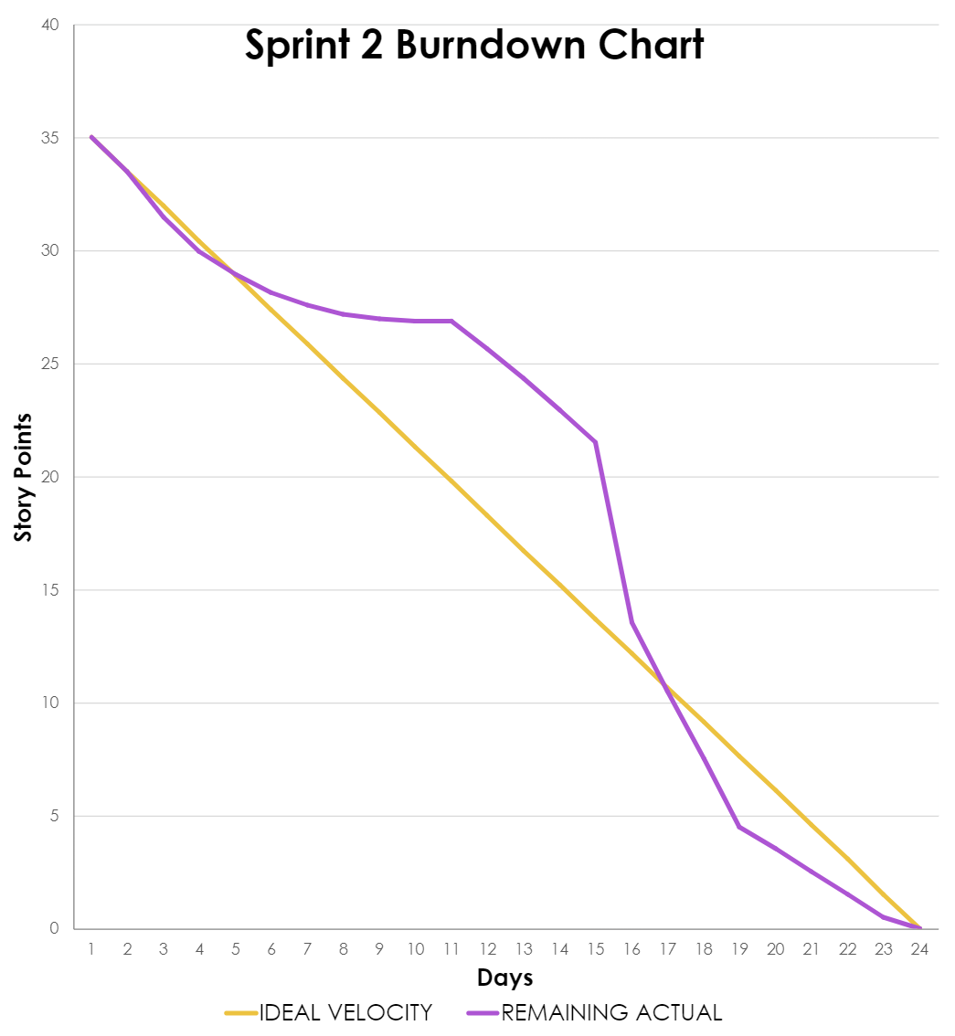
Sprint 2 Burndown Chart

Slide 49
Sprint 3 Summary:
Estimation | User Story ID | As a | I want | So that | Feature | Assignee
8 | 6 | Doctor | to add comments to patient x-ray results | patients are informed early about other information the result does not provide | Doctor Notes | Leanna / Prithvi / Ronaldo / Filippo
5 | 7 | Patient | to view whether a doctor has reviewed my x-ray results | I can be more confident about the verified results | Reviewed Status | Prithvi
1 | 9 | Doctor | to download patient x-ray reports | I can store patient records locally | Download Report | Chris / Prithvi
1 | 10 | Patient | to download my x-ray reports | I can store patient records locally | Download Report | Chris / Prithvi
2 | 13 | Patient | to quickly view my latest x-ray report | my most recent information is easily accessible | Dashboard | Ronaldo / Prithvi
8 | 16 | Doctor | to browse a specific report and record | I can quickly locate specified information | Search | Ronaldo / Prithvi
8 | 17 | Patient | to browse a specific report and record | I can quickly locate specified information | Search | Ronaldo / Prithvi
Sprint 3 Story Points: 33

Slide 50
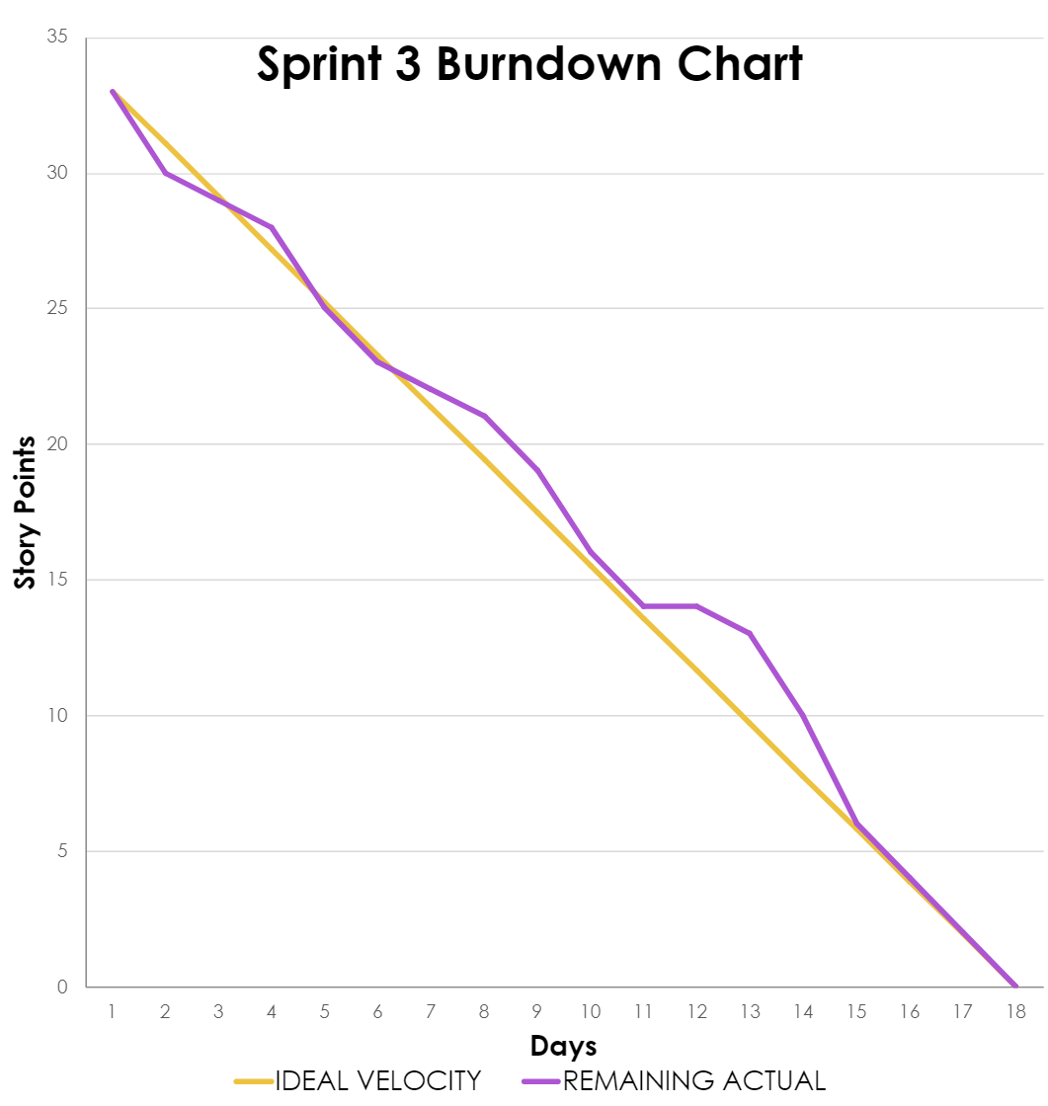
Sprint 3 Burndown Chart

Slide 51
Sprint 4 Backlog:
Estimation | User Story ID | As a | I want | So that | Feature | Assignee
2 | 8 | Patient | my x-ray results to be explained in simpler terms | I can better understand my diagnosis and health issue | Result Description | Rahul / Prithvi / Marla
5 | 11 | Patient | to have access to all of my x-ray report history | I can track my chest health issues | Report History | Prithvi / Marla
5 | 12 | Doctor | to have access to all patient x-ray report histories | I can track patient chest health issues | Report History | Prithvi / Marla
5 | 14 | Patient | to be notified once there is a change to my reports (upload, review, notes, etc.) | I can be informed about any updates as soon as possible | Notification | Leanna / Filippo
5 | 15 | Doctor | to be notified once there is a change to patient reports (upload, report, etc.) | I can be informed about any updates as soon as possible | Notification | Leanna / Filippo
3 | 18 | Radiologist | to register and store my personal info (ID, name, D.O.B.) in my own account | I can access patient information and connect with patients and doctors privately | Registration / Signup | Ronaldo / Prithvi
Sprint 4 Story Points: 44

Slide 52
Sprint 4 Backlog:
Estimation | User Story ID | As a | I want | So that | Feature | Assignee
3 | 19 | Doctor | to register and store my personal info (ID, name, D.O.B.) in my own account | I can access patient information and connect with patient and radiologists privately | Registration / Signup | Ronaldo / Prithvi
3 | 20 | Patient | to register and store my personal info (ID, name, D.O.B.) in my own account | I can access my medical information and connect with doctors privately | Registration / Signup | Ronaldo / Prithvi
3 | 21 | Patient | to login and logout of my own account | My medical information, records and reports are secure | Login/Logout | Prithvi / Ronaldo
3 | 22 | Doctor | to login and logout of my own account | Patient medical information, records and reports are secure | Login/Logout | Prithvi / Ronaldo
3 | 23 | Patient | to login using my e-mail address | I can access my medical information, records and reports | Login/Logout | Ronaldo
3 | 24 | Doctor | to login using my medical professional ID number | I can access patient medical information, records and reports | Login/Logout | Ronaldo
Sprint 4 Story Points: 44

Slide 53
Sprint 4 Backlog:
Estimation | User Story ID | As a | I want | So that | Feature | Assignee
1 | 25 | Patient | update my personal information such as my name, address, phone number etc. | the portal has up-to-date information in the event I need to be reached urgently | Profile | Anthony / Chris
Sprint 4 Story Points: 44

Slide 54
Test Cases
Test ID | User Story ID | Feature to Test | Test Case | Test Steps | Test Data | Expected Result | Actual Result | Pass/ Fail | Comments
19 | 23 | Login / Logout | Successfully login to the patient or doctor portal | Sign in as a Patient -> Type in e-mail and password -> Click Login | User credentials | Logging in to the patient portal | Logged in as Angela Fernandez | Pass
20 | 23 | Login / Logout | Incorrect e-mail address is provided | Sign in as a Patient -> Type incorrect e-mail -> Type in password | User credentials | Error Message is displayed | Invalid user/auth credentials | Pass
21 | 23 | Login / Logout | Incorrect password is provided | Sign in as a Patient -> Type correct e-mail -> Type incorrect password | User credentials | Error Message is displayed | Invalid user/auth credentials | Pass
22 | 18, 19, 20 | Registration / Signup | Successfully creating a patient account | Sign in as a Patient or Doctor -> Click on Need an Account? Click Here -> Type in your full name, e-mail, confirm e-mail, enter password -> Click Sign Up | User credentials | Successfully creates an account | Dashboard is displayed | Pass
Pass/ Fail Ratio: 14/14 = 100%

Slide 55
Test Cases
Test ID | User Story ID | Feature to Test | Test Case | Test Steps | Test Data | Expected Result | Actual Result | Pass/ Fail | Comments
23 | 18, 19, 20 | Registration / Signup | Duplicate e-mail address is used to create an account | Click on Patient Sign Up -> Type in full name, email, and password -> Click Sign Up | User credentials | Error Message is displayed | This email address is already in use | Pass
24 | 18, 19, 20 | Registration / Signup | Different email & same name and password | Click on Patient Sign Up -> Type in full name, email and password -> Click Sign Up | User credentials | Successfully creates an account | Dashboard is displayed | Pass | Despite all other user credentials being the same, a new account is created because the password is unique to that user
25 | 18, 19, 20 | Registration / Signup | Leaving fields blank | Click on Doctor or Patient Sign Up -> Leave fields blank -> Click Sign Up | User credentials | Error Message is displayed | Please fill out this field | Pass
Pass/ Fail Ratio: 14/14 = 100%

Slide 56
Test Cases
Test ID | User Story ID | Feature to Test | Test Case | Test Steps | Test Data | Expected Result | Actual Result | Pass/ Fail | Comments
26 | 18, 19, 20 | Registration / Signup | Providing an invalid e-mail address | Click on Doctor or Patient Sign Up -> Type an invalid e-mail address -> Type in remaining fields -> Click Sign Up | User credentials | Error Message is displayed | Please include an '@' in the email address | Pass | As long as the user provides an @ it will be accepted. It does not verify the e-mail belongs to the user.
27 | 18, 19, 20 | Registration / Signup | Password requirements | Click on Doctor or Patient Sign Up -> Type in full name, email, and a password not meeting requirements -> Click Sign Up | User credentials | Error Message is displayed | Password must contain at least one uppercase letter, one special character, and be at least 6 characters long. | Pass
Pass/ Fail Ratio: 14/14 = 100%

Slide 57
Test Cases
Test ID | User Story ID | Feature to Test | Test Case | Test Steps | Test Data | Expected Result | Actual Result | Pass/ Fail | Comments
28 | 25 | Profile | Updating User Profile | Sign in as a Patient or Doctor -> Type in user credentials -> Click Login -> Click on Profile Image -> Click on Profile Button | User Information | New Fields (date of birth, sex at birth, contact number, city, state, zip code) are populated in Firebase | User Information is updated in Firebase | Pass
29 | 25 | Profile | Leaving User Profile fields blank | Sign in as a Patient or Doctor -> Type in user credentials -> Click Login -> Click on Profile Image -> Click on Profile Button | User Information | Error Message is displayed | Please fill out this field | Pass
30 | 15 | Notification | Notification of a new report upload in dropdown | Sign in as a Doctor -> Click on bell icon | X-ray Document | A notification message with associated report ID(s) is displayed in the dropdown | Report:0000 A new report has been uploaded | Pass
Pass/ Fail Ratio: 14/14 = 100%

Slide 58
Test Cases
Test ID | User Story ID | Feature to Test | Test Case | Test Steps | Test Data | Expected Result | Actual Result | Pass/ Fail | Comments
31 | 14 | Notification | Notification of changes to reports in dropdown | Sign in as a Patient -> Click on bell icon | String comments | A notification message with associated report ID(s) is displayed in the dropdown | You have an update on Report: 0000 | Pass
32 | 8 | Result Description | A friendly definition of the medical diagnosis | Sign in as a Patient or Doctor -> Click on Report -> Click on one of the Reports | X-ray Document | A user-friendly definition of the diagnosis is displayed below the medical term | The presence of denser, cloudy gray areas on the x-ray image against a normal dark-appearing lung. Gray areas indicate that something is occupying that area inside the lungs. | Pass
Pass/ Fail Ratio: 14/14 = 100%

Slide 59
Sprint 4 Story Completion:
Estimation | User Story ID | As a | I want | So that | Feature | Status
2 | 8 | Patient | my x-ray results to be explained in simpler terms | I can better understand my diagnosis and health issue | Result Description | Completed
5 | 11 | Patient | to have access to all of my x-ray report history | I can track my chest health issues | Report History | Completed
5 | 12 | Doctor | to have access to all patient x-ray report histories | I can track patient chest health issues | Report History | Completed
5 | 14 | Patient | to be notified once there is a change to my reports (upload, review, notes, etc.) | I can be informed about any updates as soon as possible | Notification | Completed
5 | 15 | Doctor | to be notified once there is a change to patient reports (upload, report, etc.) . | I can be informed about any updates as soon as possible | Notification | Completed
Sprint 4 Story Points: 44

Slide 60
Sprint 4 Story Completion:
Estimation | User Story ID | As a | I want | So that | Feature | Status
3 | 18 | Radiologist | to register and store my personal info (ID, name, D.O.B.) in my own account | I can access patient information and connect with patients and doctors privately | Registration / Signup | Completed
3 | 19 | Doctor | to register and store my personal info (ID, name, D.O.B.) in my own account | I can access patient information and connect with patient and radiologists privately | Registration / Signup | Completed
3 | 20 | Patient | to register and store my personal info (ID, name, D.O.B.) in my own account | I can access my medical information and connect with doctors privately | Registration / Signup | Completed
3 | 21 | Patient | to login and logout of my own account | My medical information, records and reports are secure | Login/Logout | Completed
3 | 22 | Doctor | to login and logout of my own account | Patient medical information, records and reports are secure | Login/Logout | Completed
Sprint 4 Story Points: 44

Slide 61
Sprint 4 Story Completion:
Estimation | User Story ID | As a | I want | So that | Feature | Status
3 | 23 | Patient | to login using my e-mail address | I can access my medical information, records and reports | Login/Logout | Completed
3 | 24 | Doctor | to login using my medical professional ID number | I can access patient medical information, records and reports | Login/Logout | Completed
1 | 25 | Patient | update my personal information such as my name, address, phone number etc. | the portal has up-to-date information in the event I need to be reached urgently | Profile | Completed
Sprint 4 Story Points: 44

Slide 62
Team Velocity
44 story points

Slide 63
Burndown Chart

Slide 64
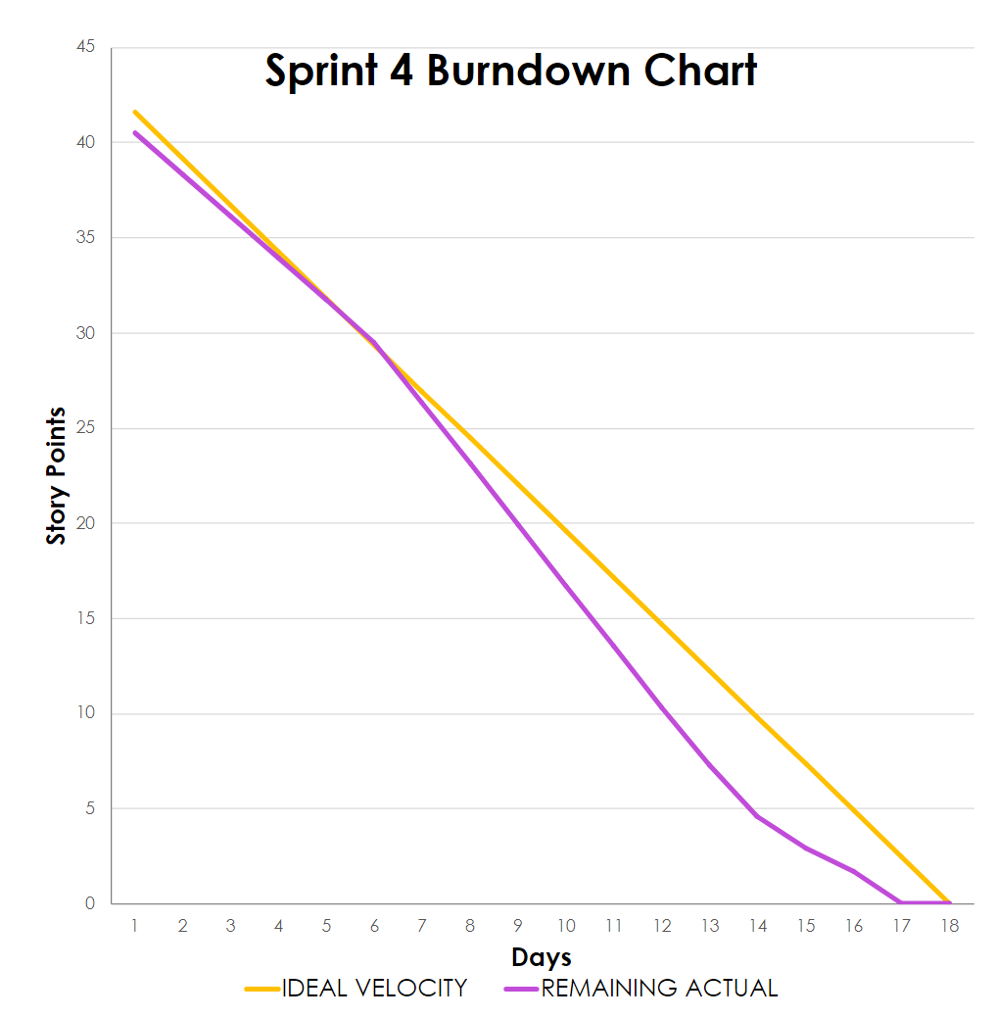
Burndown Chart

Slide 65
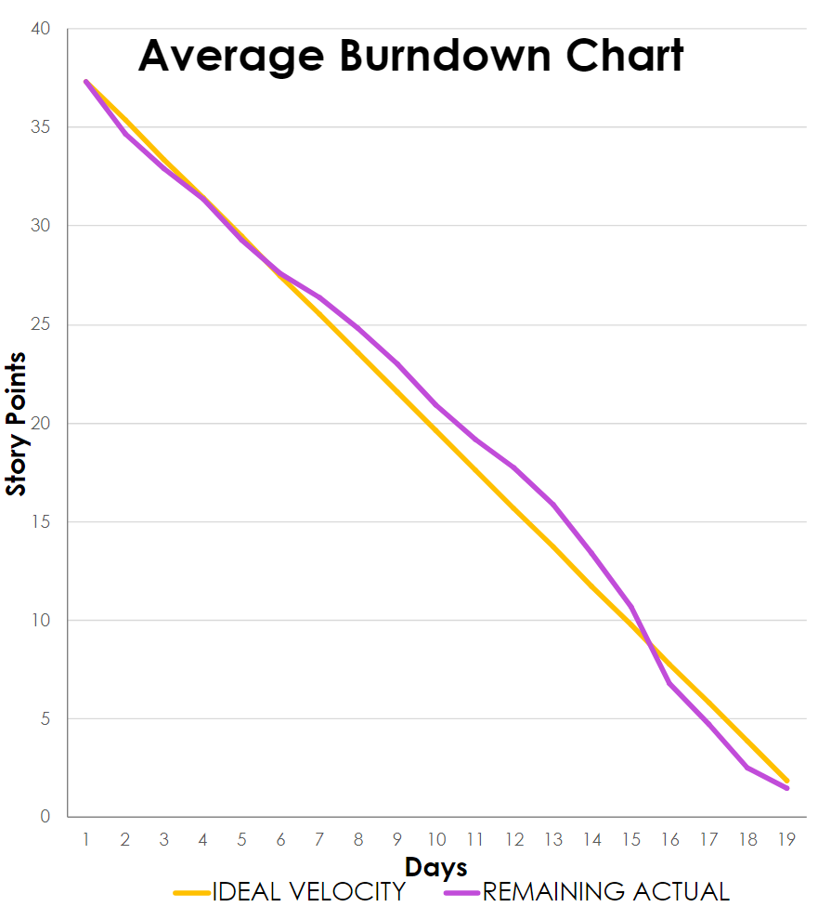
Burndown Chart

Slide 66
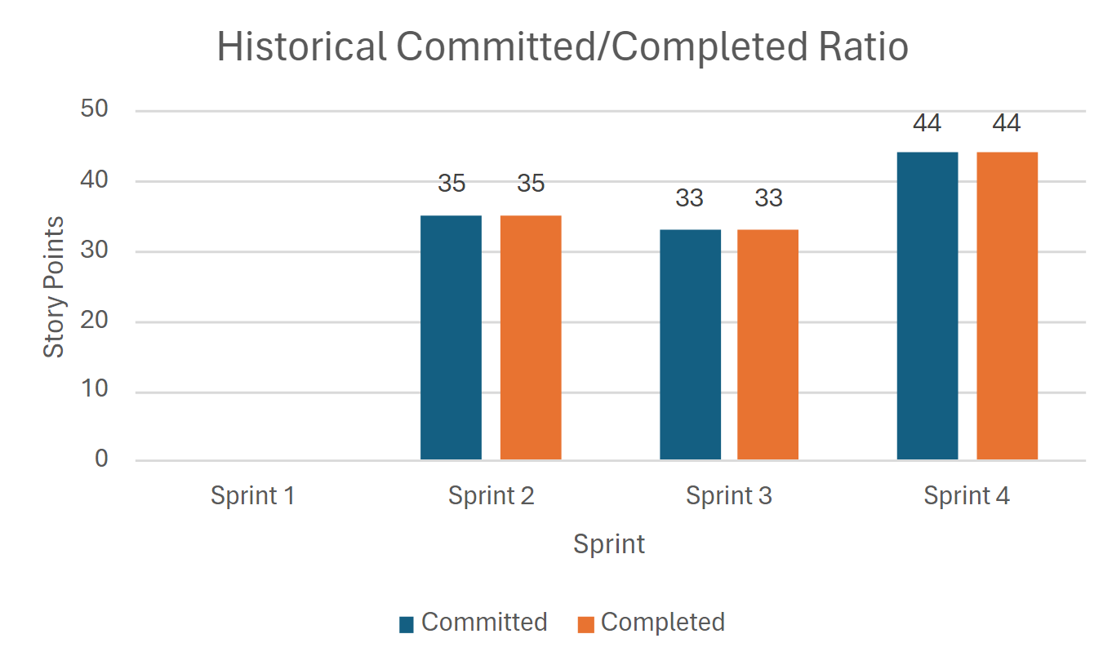
Completed / Committed Ratio
Avg
37 pts
100%
Sprint 4 Story Points: 44

Slide 67
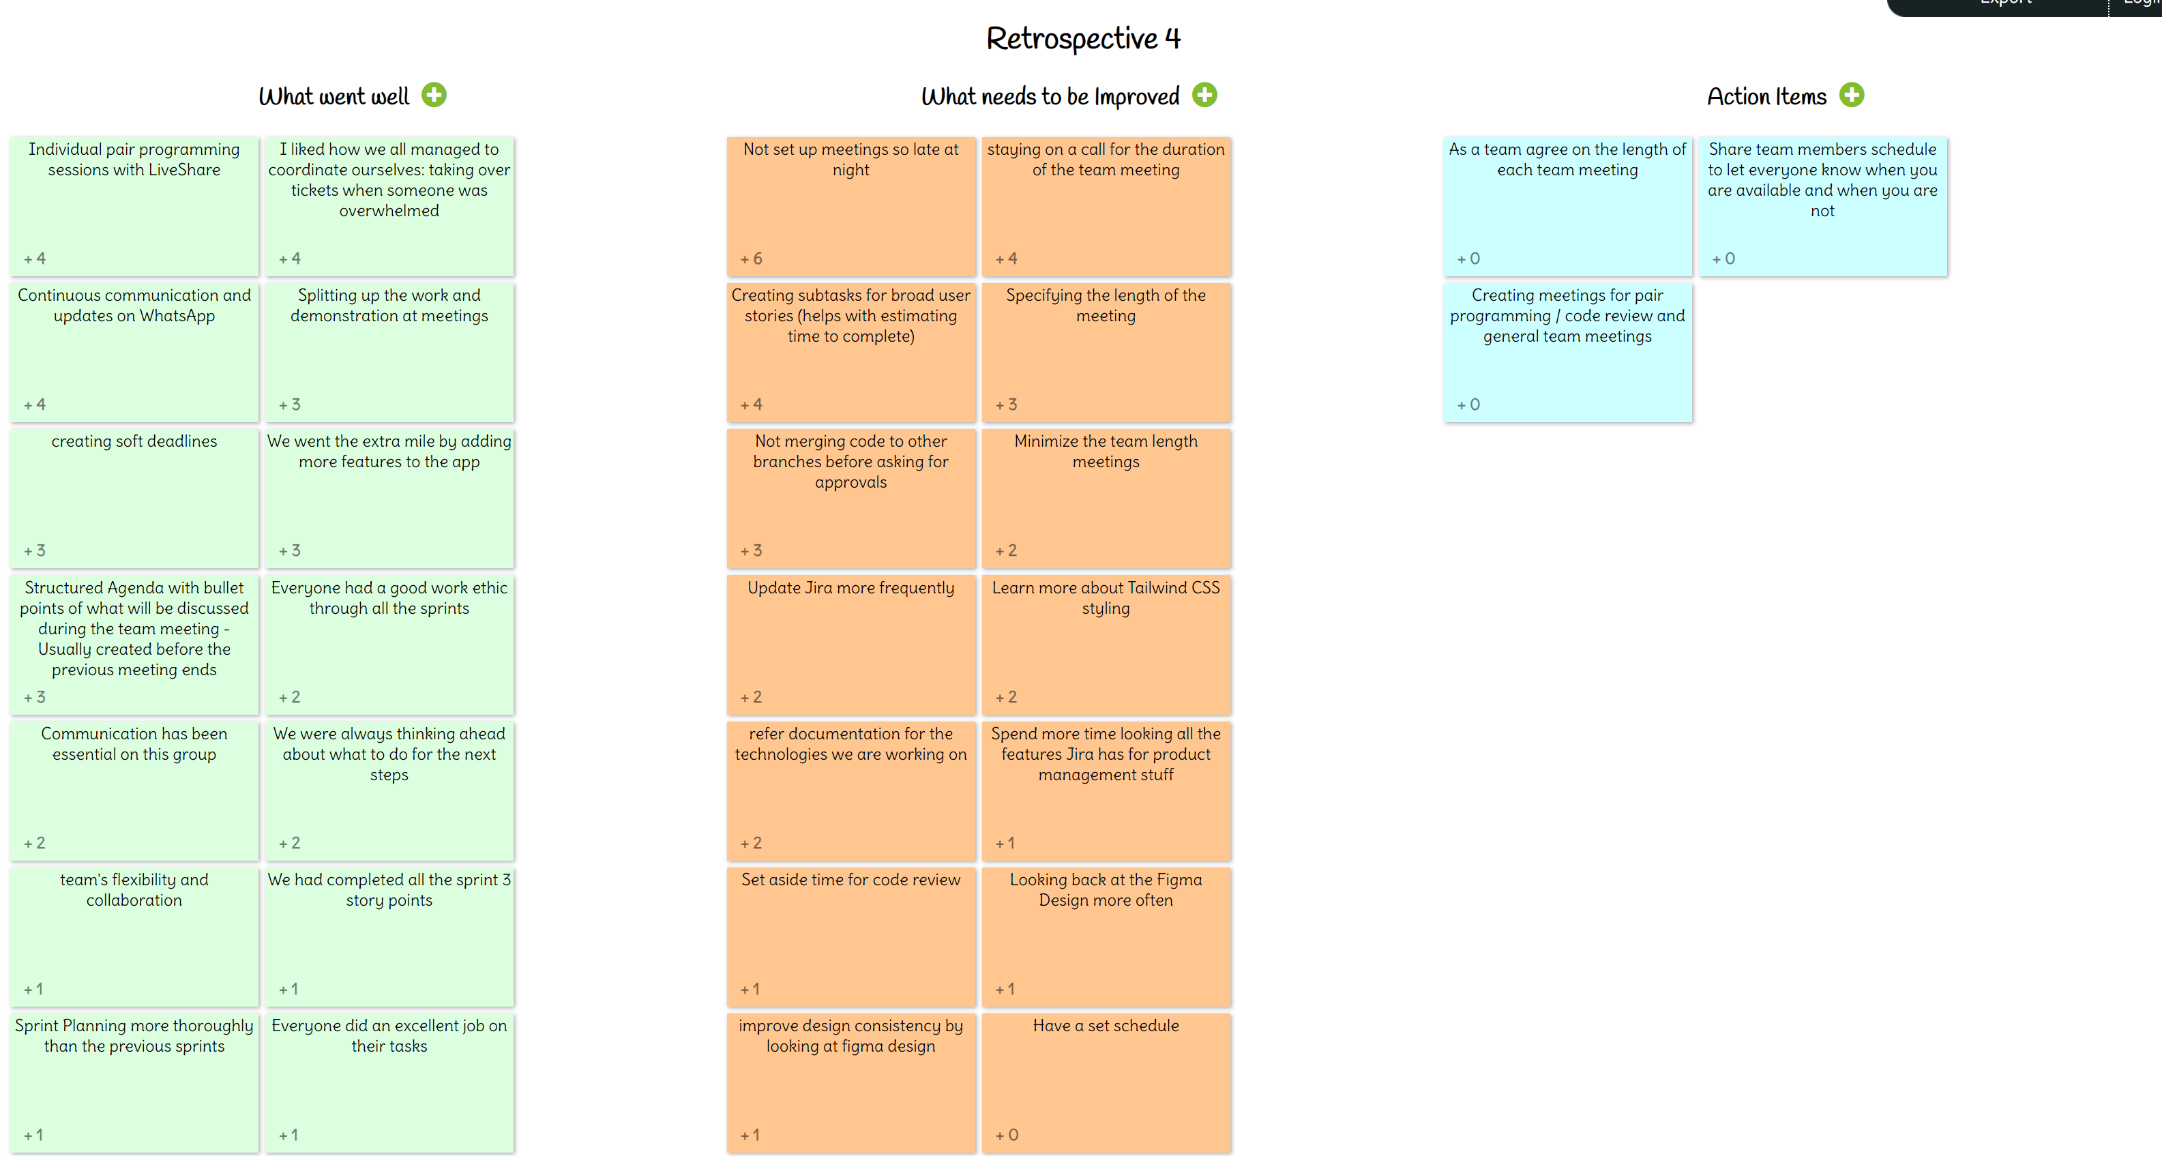
Retrospective:

Slide 68
Retrospective:
What Went
Well
What needs to be Improved
Action
Items
Pair programming sessions with LiveShare on VSCode
Coordinated ourselves and helped someone when they were overwhelmed
Continuous communication and updates on WhatsApp
Creating soft deadlines
Avoid scheduling meetings late at night
Staying on a call for the duration of the meeting
Create subtasks for broad user stories
Specify the length of the meeting / Minimize length of the meeting
As a team agree on the length of each meeting
Share team members schedule to let everyone know when you are available and when you are not
Create meetings for pair programming / code review and a separate general team meetings

Slide 69
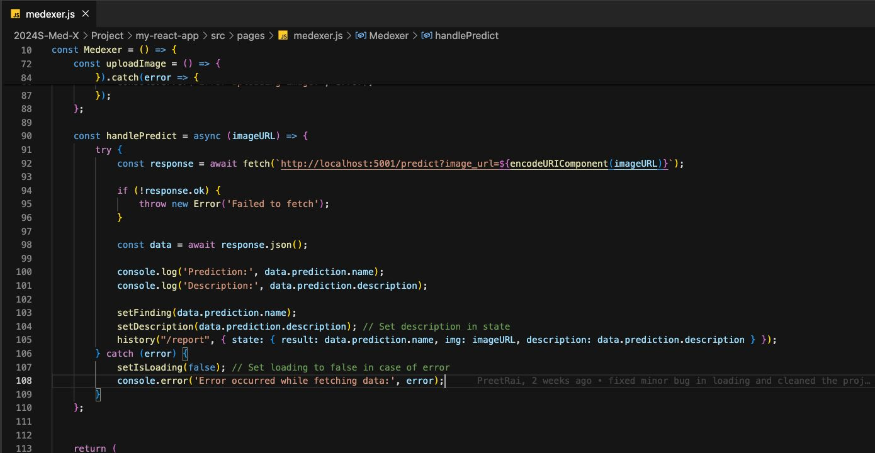
Code Snippet:

Slide 70
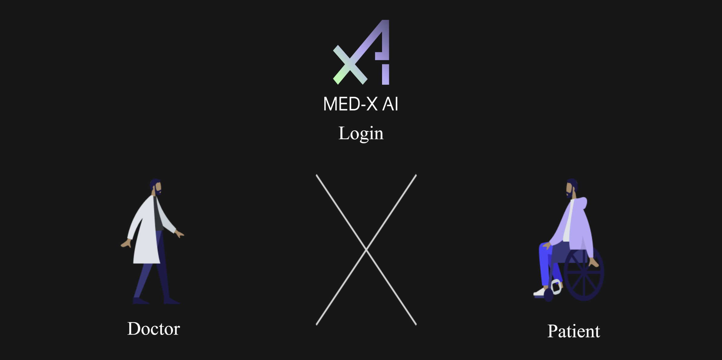
Application Screenshots:

Slide 71
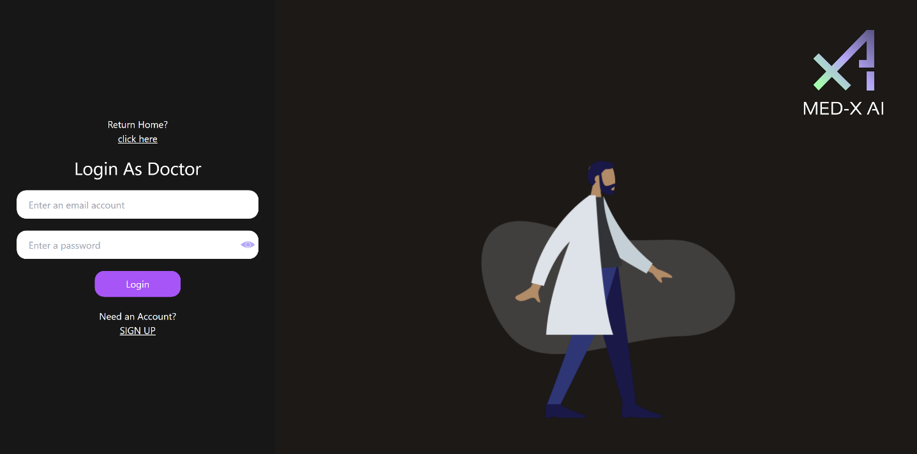
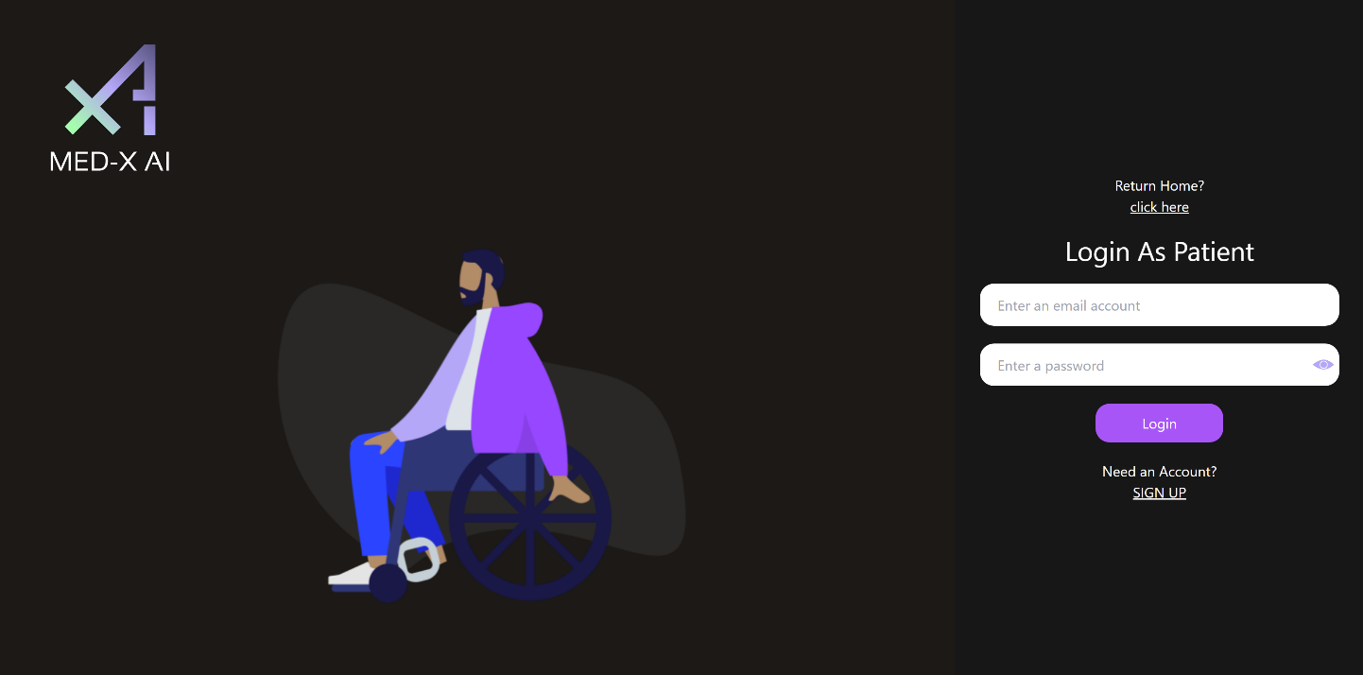
Application Screenshots:
Login Portals
Doctor
Patient

Slide 72
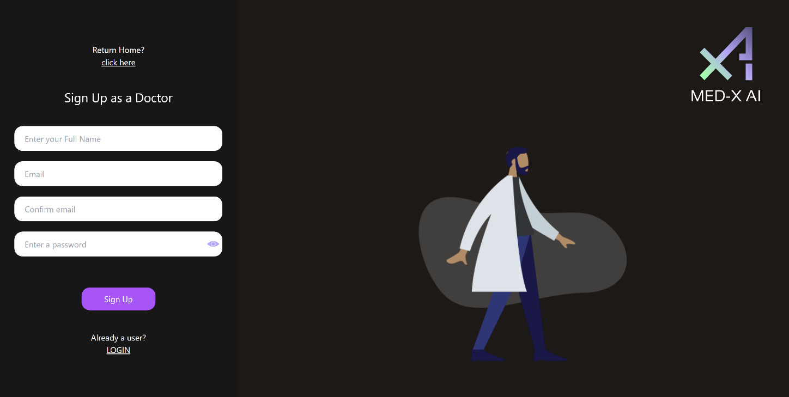
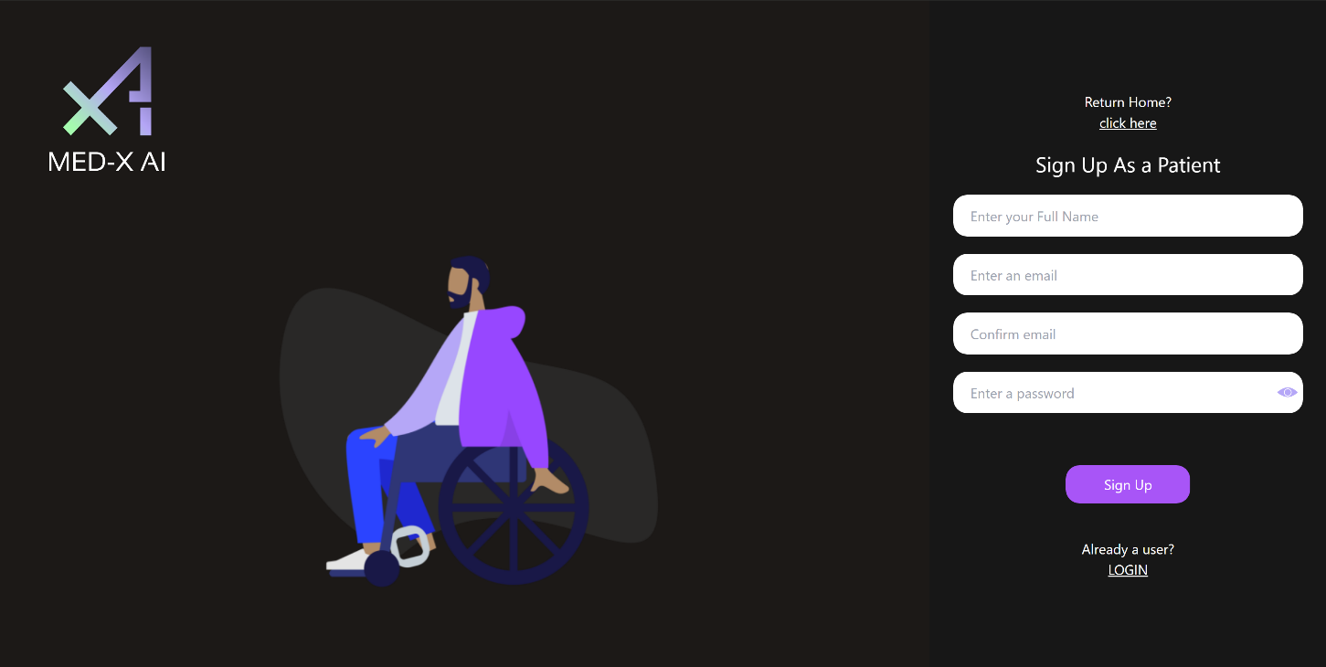
Application Screenshots:
Registration Pages
Doctor
Patient

Slide 73
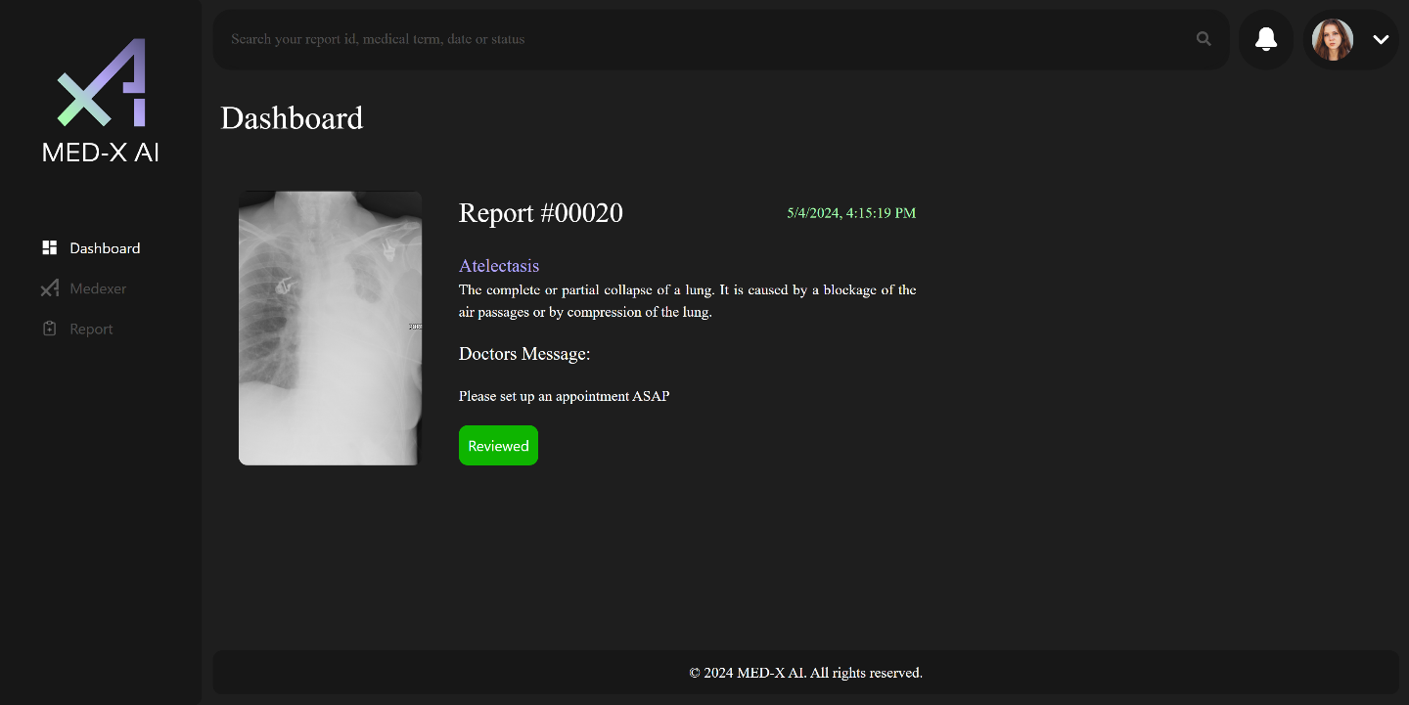
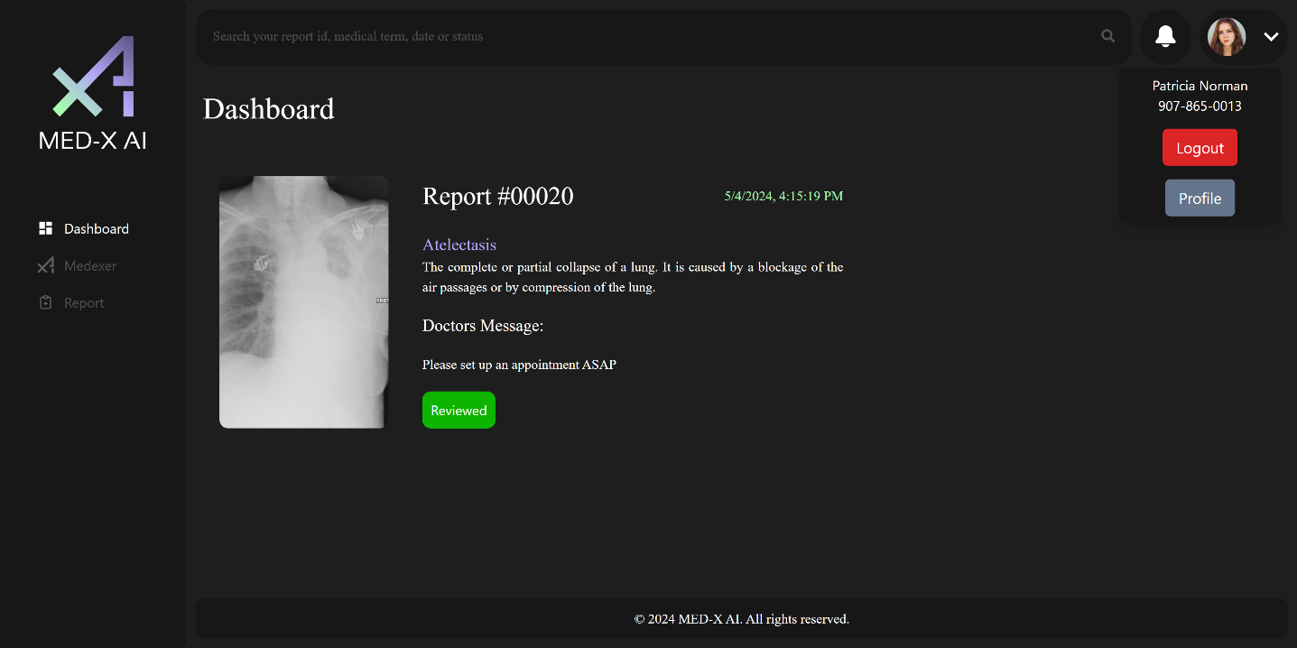
Application Screenshots:
Doctor Dashboard

Slide 74
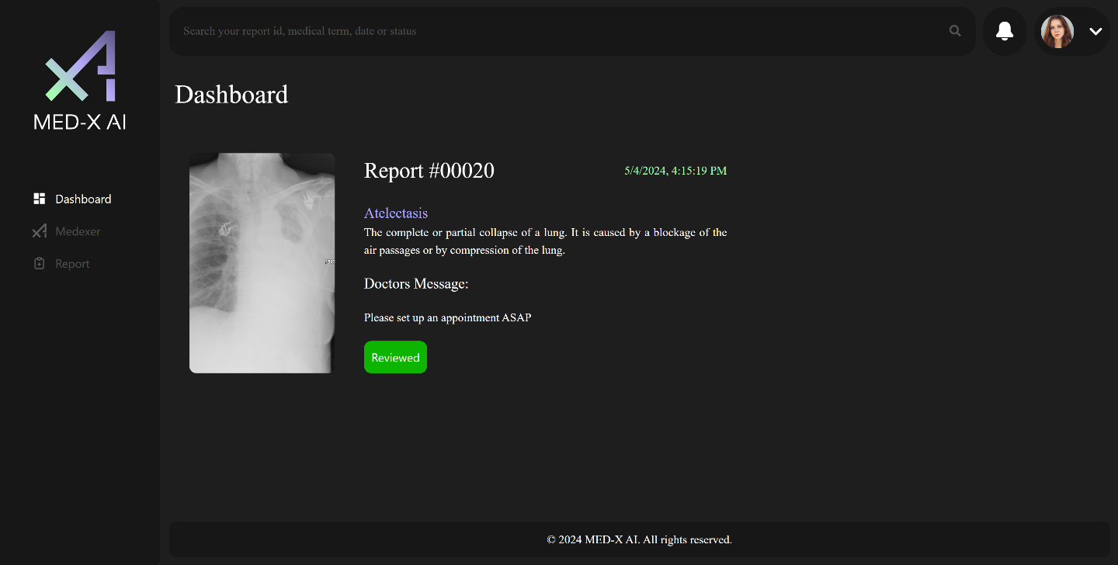
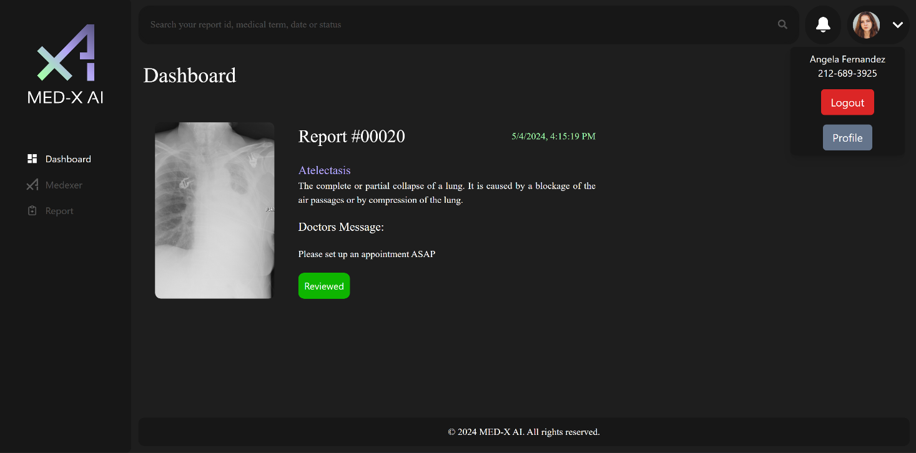
Application Screenshots:
Patient Dashboard

Slide 75
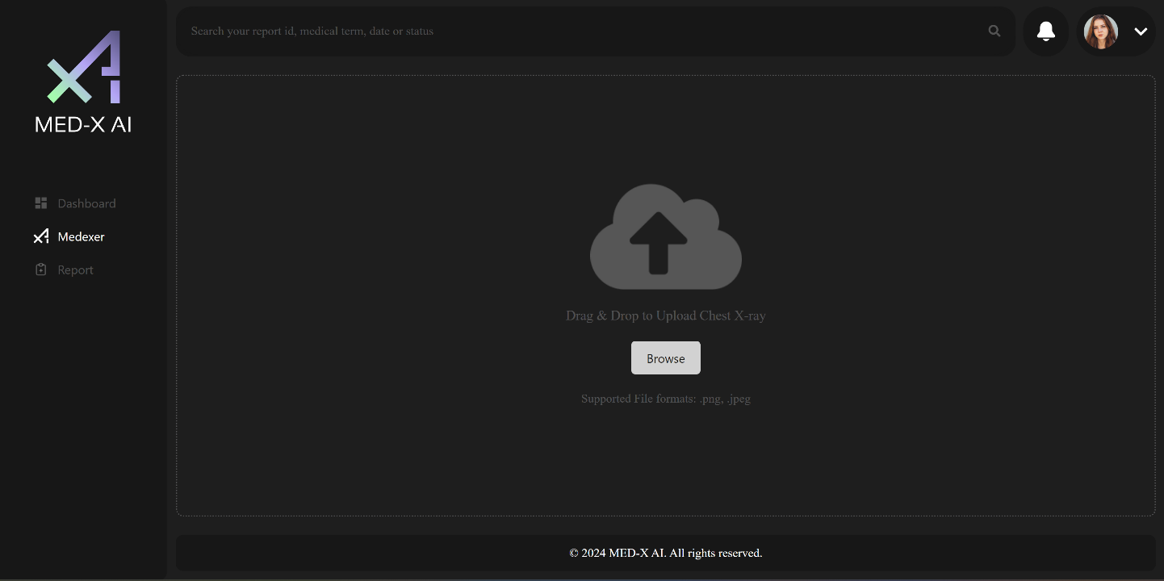
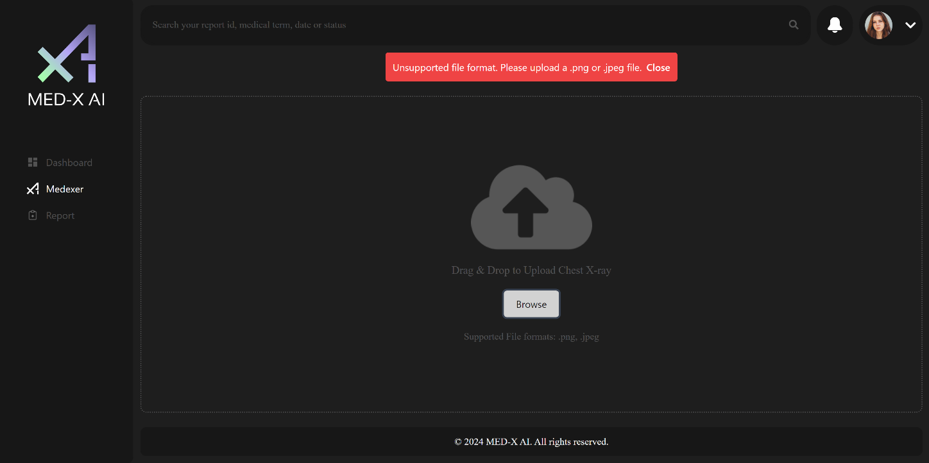
Application Screenshots:
Medexer (Upload Chest X-ray)

Slide 76
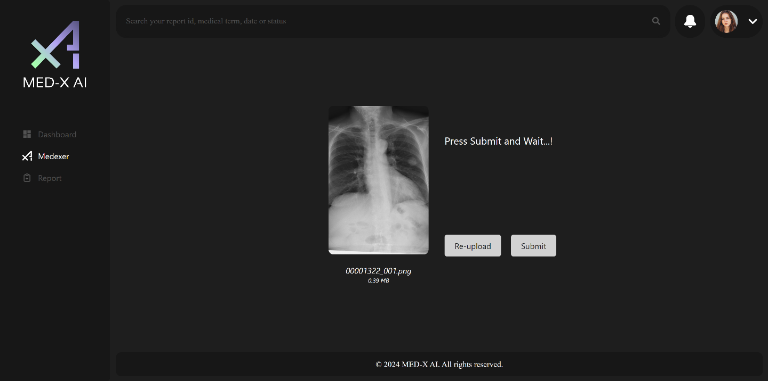
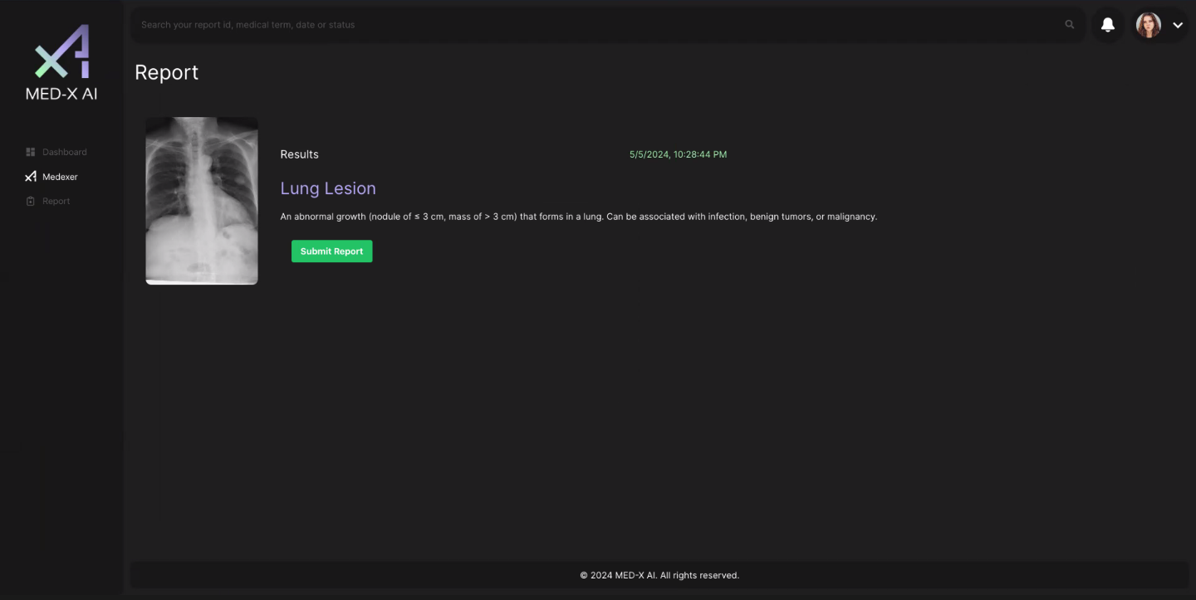
Application Screenshots:

Slide 77
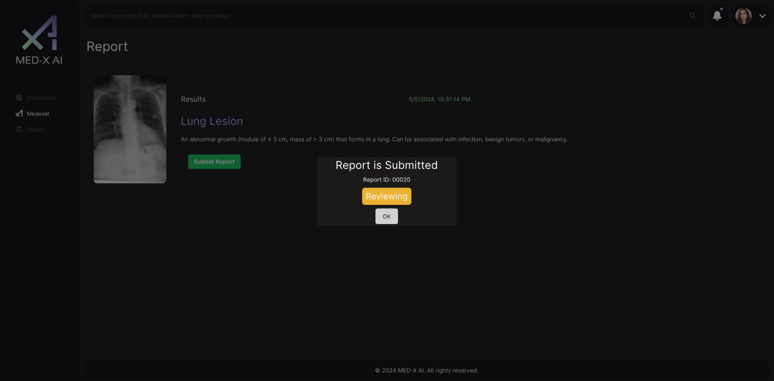
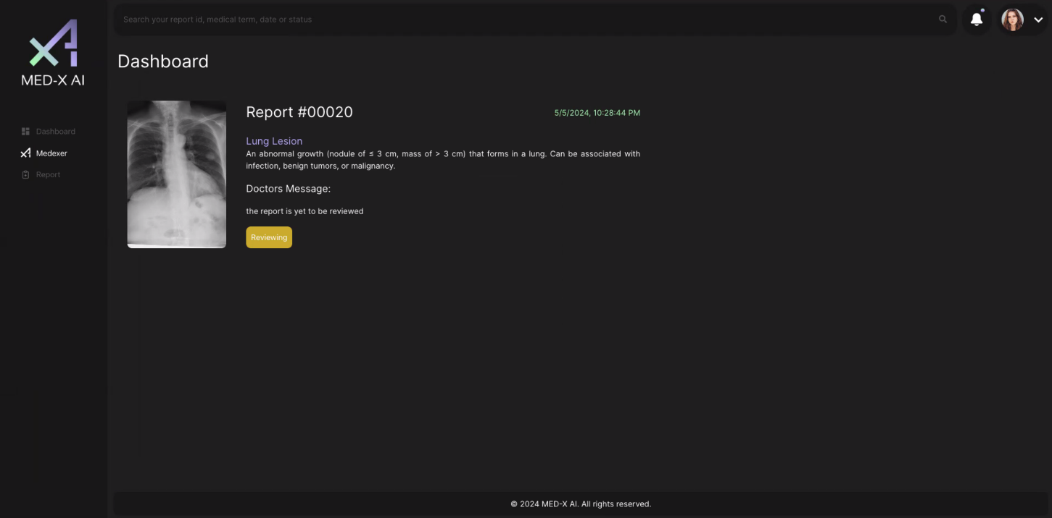
Application Screenshots:

Slide 78
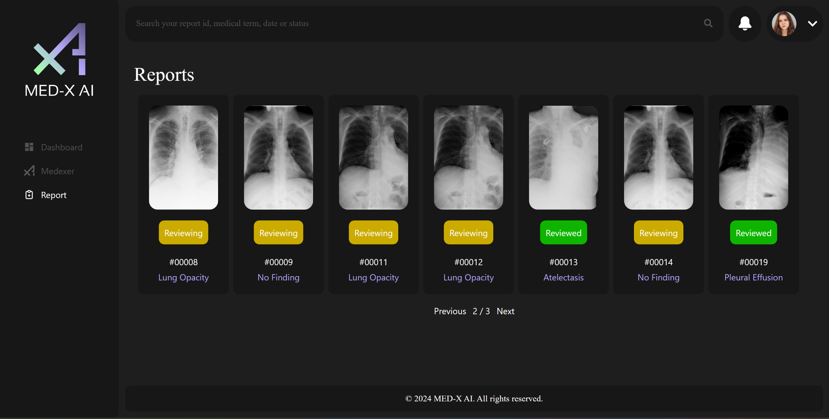
Application Screenshots:
Report Gallery

Slide 79
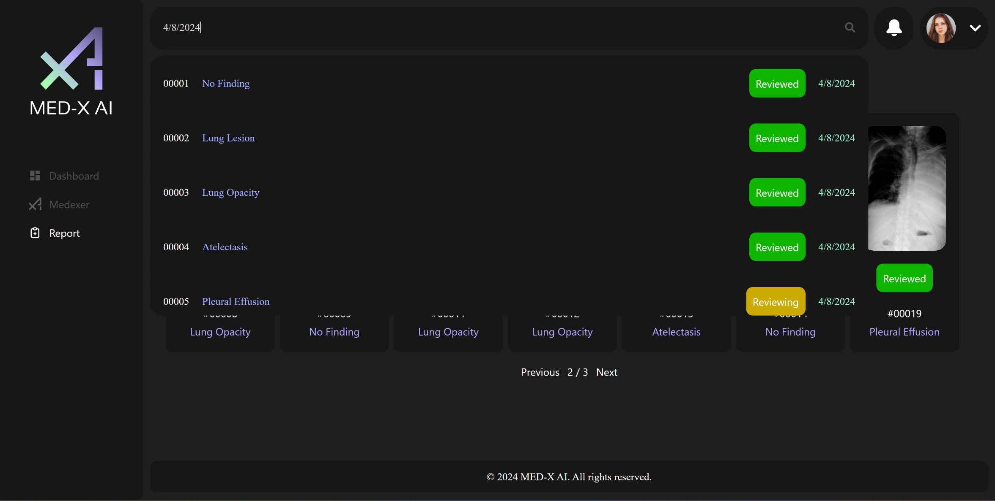
Application Screenshots:
Search Bar

Slide 80
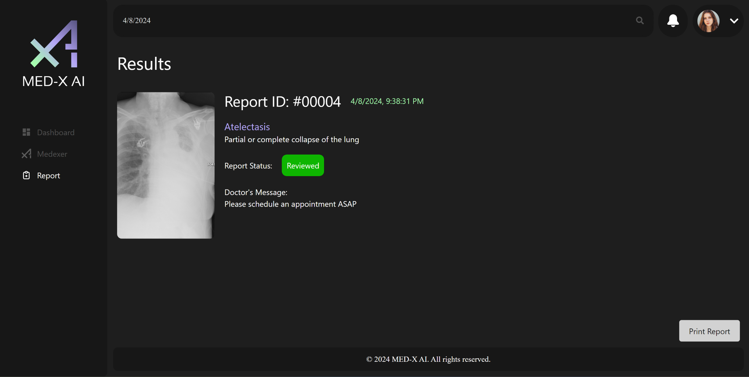
Application Screenshots:
Report

Slide 81
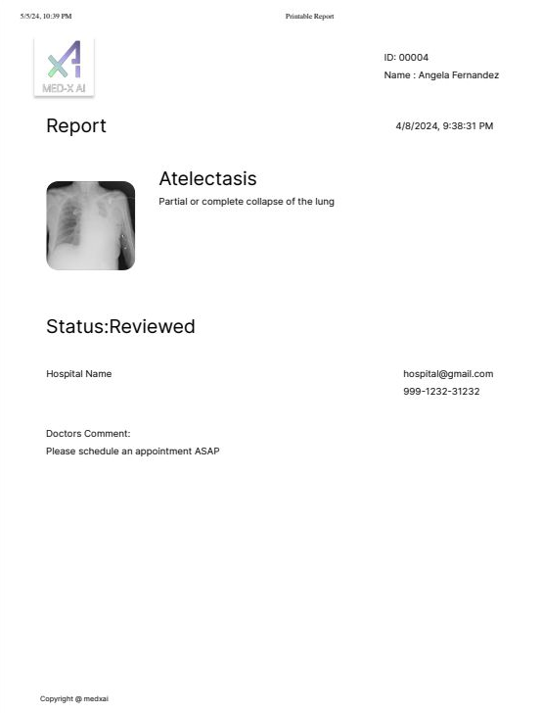
Application Screenshots:
PDF Report
Printable Report

Slide 82
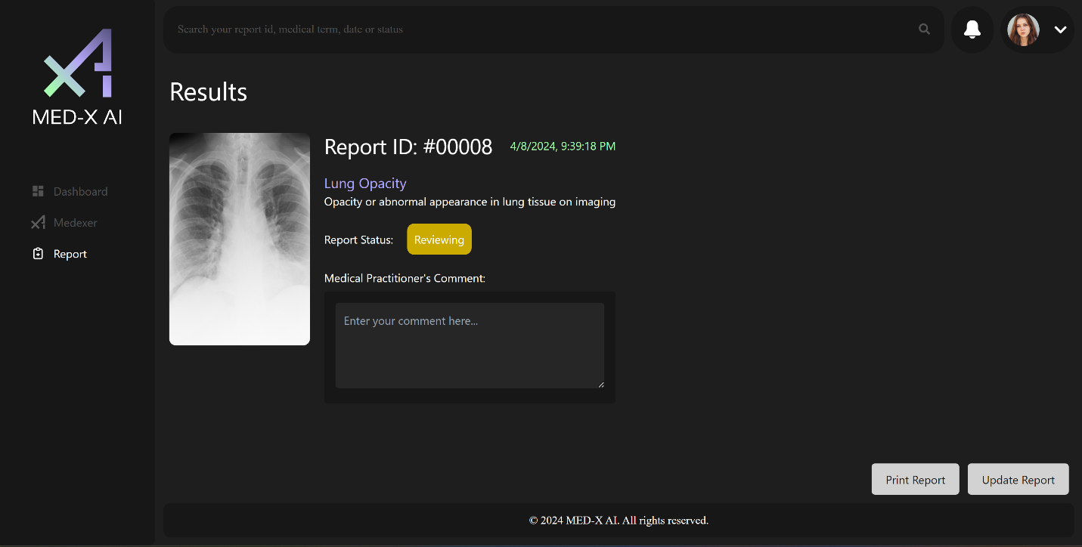
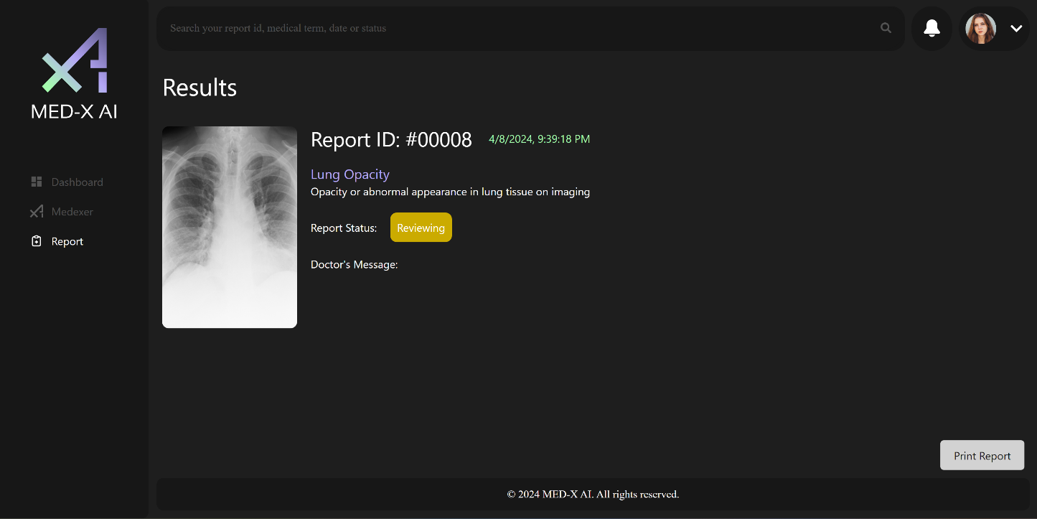
Application Screenshots:
Report
Doctor
Patient

Slide 83


Application Screenshots:
Doctor Comment

Slide 84


Application Screenshots:
Doctor Notification

Slide 85


Application Screenshots:
Patient Notification

Slide 86


Application Screenshots:
Updating Profile Information
Doctor
Patient

Slide 87


Firebase API:
Notes:
We chose Firebase over MongoDB because Firebase cloud services come with google APIs which allow our team to use our urls of our images with vast array of cloud services provided by Google and third-party providers.
In Medxer page, we import the apis to access Firebase's storage services like ref, getDownloadURL, and UploadBytes.
We use the first to create a reference from the storage service, the second to copy the google-generated api embedded inside the uploaded images urls for later use, and finally uploadBytes generates the url of the uploaded image by converting the JavaScript object into bytes.

Slide 88


Flask/Cors:
Notes:
Advantages to using Flask:
Continuous Python runtime environment and library similar to NodeJS
The CORS class allows for direct exposure of the back-end service without using middleware like proxy.
Ease of use and customization of back-end services

Slide 89


Docker for CI/CD:
SPRINT 2
SPRINT 3
Notes:
Dockerizing the back-end allowed our team to receive consistent test results on our machines because the app's dependencies are executed in a virtual environment based on a Linux kernel that encapsulates the Flask runtime environment for Python executables.
As you can see from the container's terminal view, the average response time for the back-end API response is twice as fast, the average speed is 59 ms, a considerable drop from 121 ms experienced in the Jupyter notebook in which we tested the neural network.

Slide 90

Docker:
Notes:
Perhaps, the greatest benefit of dockerizing both the front-end and back-end is booting into the application in seconds after clicking on the containers' ports instead of executing docker commands in our terminals.

Slide 91

Live Application Demo:

Slide 92
Future Enhancements:
Update e-mail through Profile page
Chat Assistance Bot
E-mail Confirmation after successful sign-up
Linking notifications to e-mail
Top 3 diagnosis with close percentages will be displayed for Medical Professionals
Further improve the accuracy of the CNN
Test the web application with medical industry
Ability to schedule an appointment

Slide 93
Wikipage Link
https://github.com/htmw/2024S-Med-X/wiki

